Slide 1
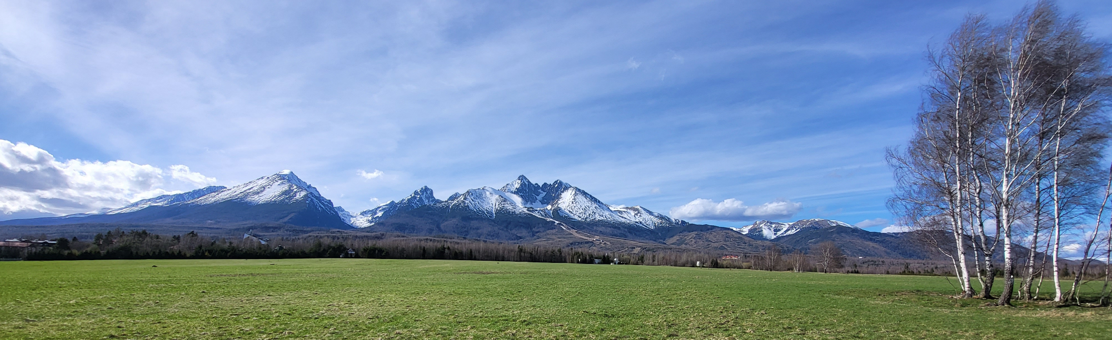
Natural threats within the reach of important tourist routes in the Tatra Mountains (Slovakia)
Gabriel Bugár ¹, Veronika Piscová ², Juraj Hreško,¹
¹ Department of Eclology and Environmentalistics, Faculty of Natural Sciences an Informatics, Constantine The Philosopher University in Nitra, 949 01 Nitra; ² Institute of Landscape Ecology, Slovak Academy of Sciences, Bratislava, Branch Nitra, 949 01 Nitra

Slide 2
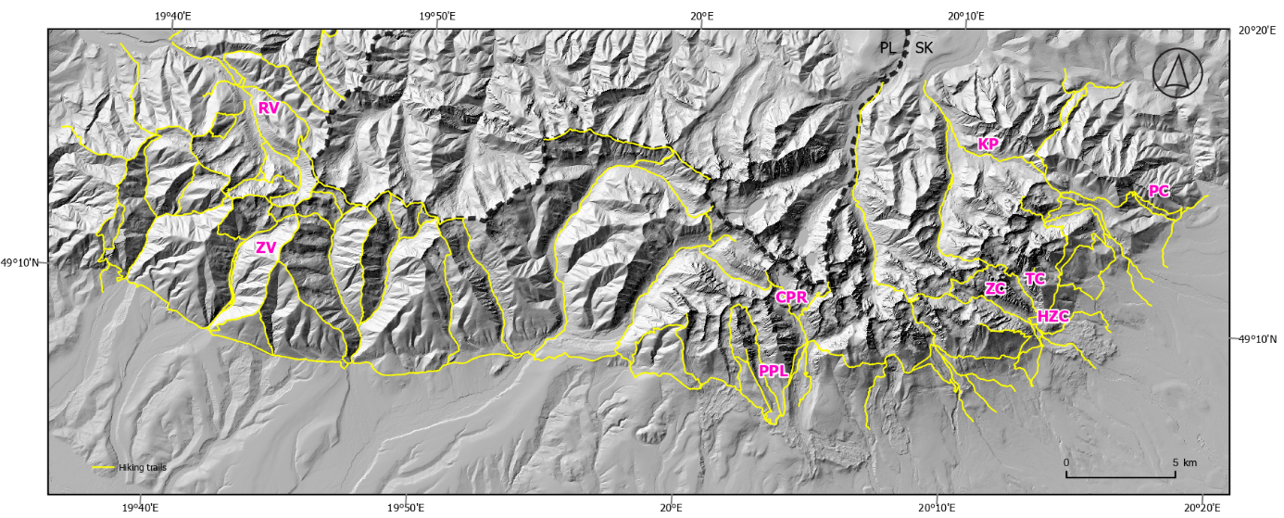
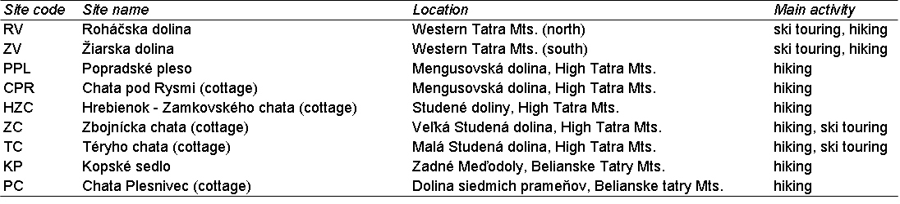
Introduction
At the beginning, it should be said that under the term "significant tourist trails" includes trails open year-round, trails that lead to tourist huts (cottages), and those represent entry routes to other important trails.

Slide 3
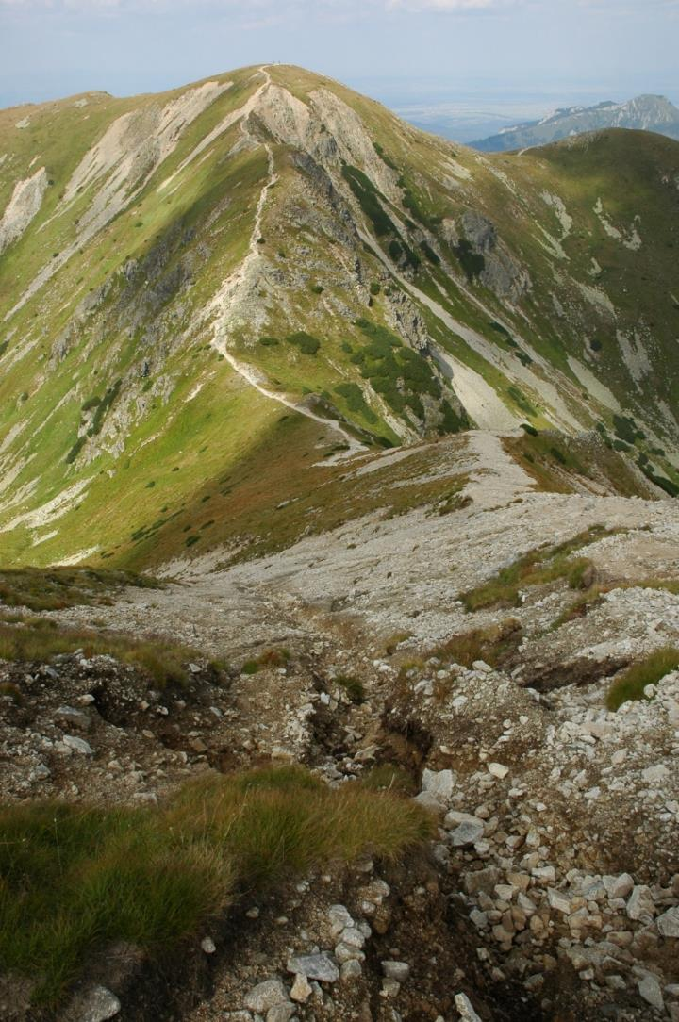
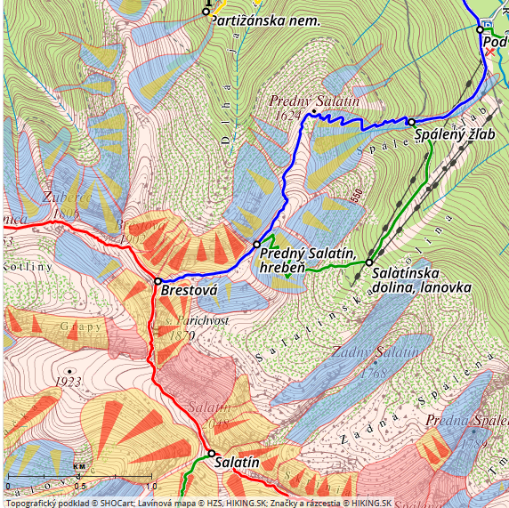
WESTERN TATRAS
Brestová (1902 m asl)
Ends of Roháčska (RV) and Jalovecká valleys – permanently influenced by the cumulative effects of gravitational, water-gravitational and nival processes.
Intensive cumulative effects, nivation, deflation and fluvial erosion in the ends of the gullies – source zones of avalanches and debris flows on the distribution ridge between Jalovecká valley (left side) and Roháčska valley (right side). Route of a significant tourist trail at the start of the crossing of the Western Tatras ridge from the Liptov and Orava regions. The geological bedrock consists of granitoid rocks, often disturbed by tectonic faults, mylonite zones, but also gravitational faults of the rock massif. Brestová (1902 m a.s.l., saddle 1870 m alt., Salatín (2048 m alt.)
Roháčska valley
Jalovecká valley
In February 2009, an avalanche killed a Polish tourist. The snow mass descended down to the Roháčska Valley to one of the Roháčske lakes.

Slide 4
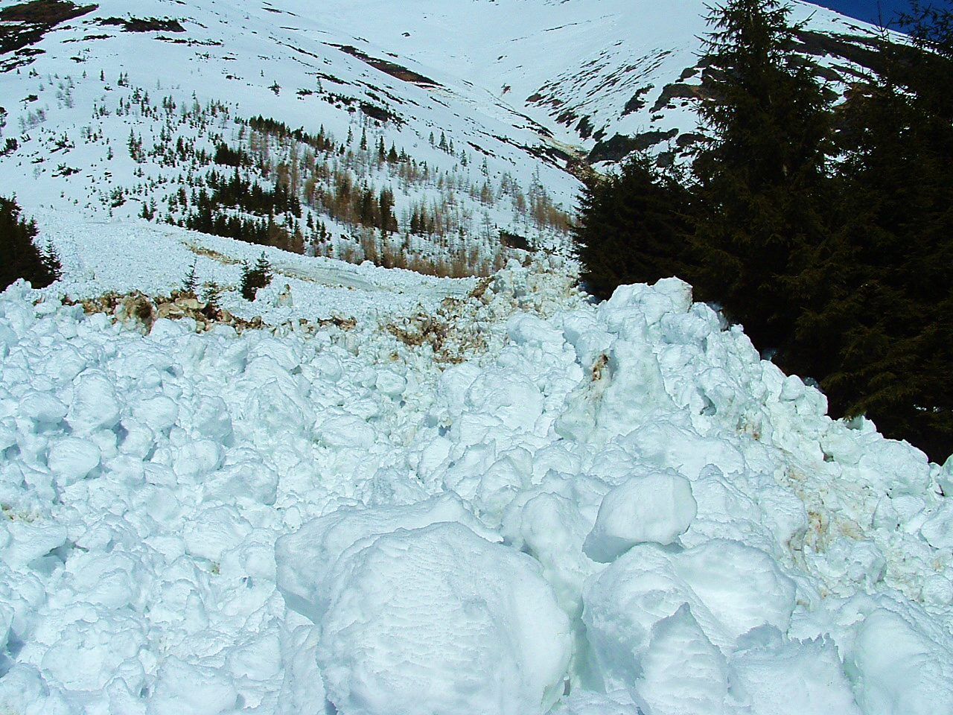
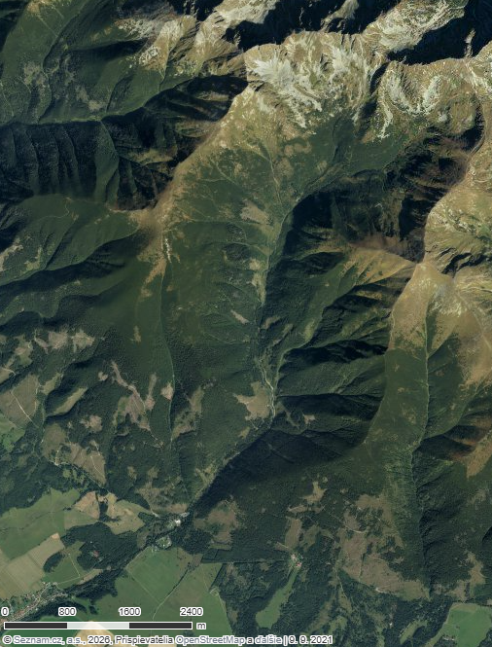
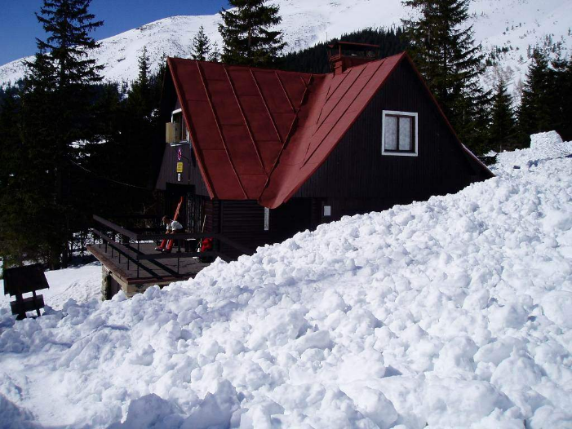
ZV
One of the most dangerous valleys during winter is Žiarska valley. The trail to the tourist hut is accessible and open all year round (closed if avalanche danger is at level 4 and higher).
April 3-4, 2005
Žiarska valley – wet snow avalanches immediately threatened the access road, hiking trail and the Mountain Rescue Service hut, resulting in the injury of a skier who was pushed into the area of ​​the HZS building by the snow mass.
Žiarska valley (ZV)
AVALANCHE HAZARD
avalanches with a high frequency of occurrence

Slide 5
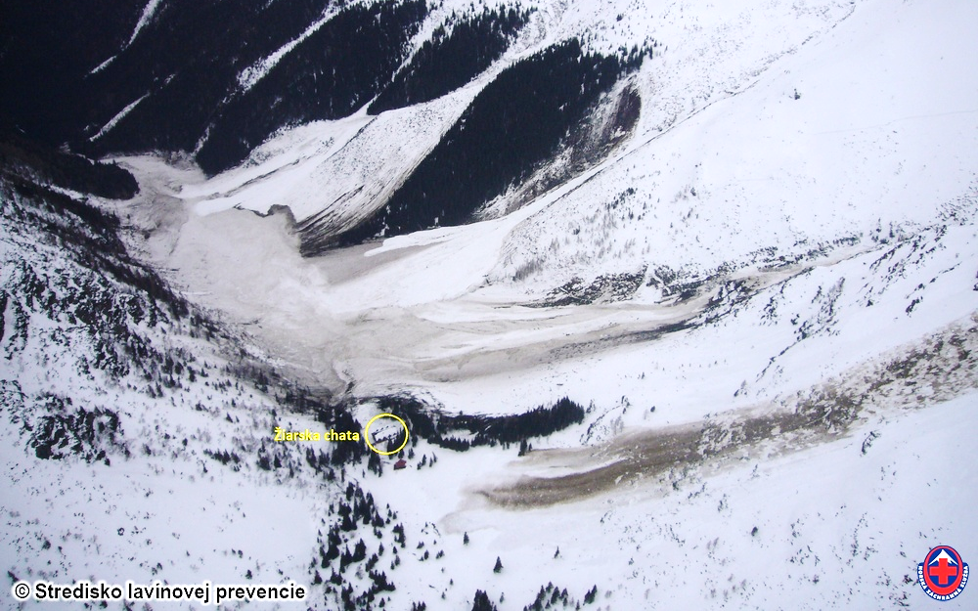
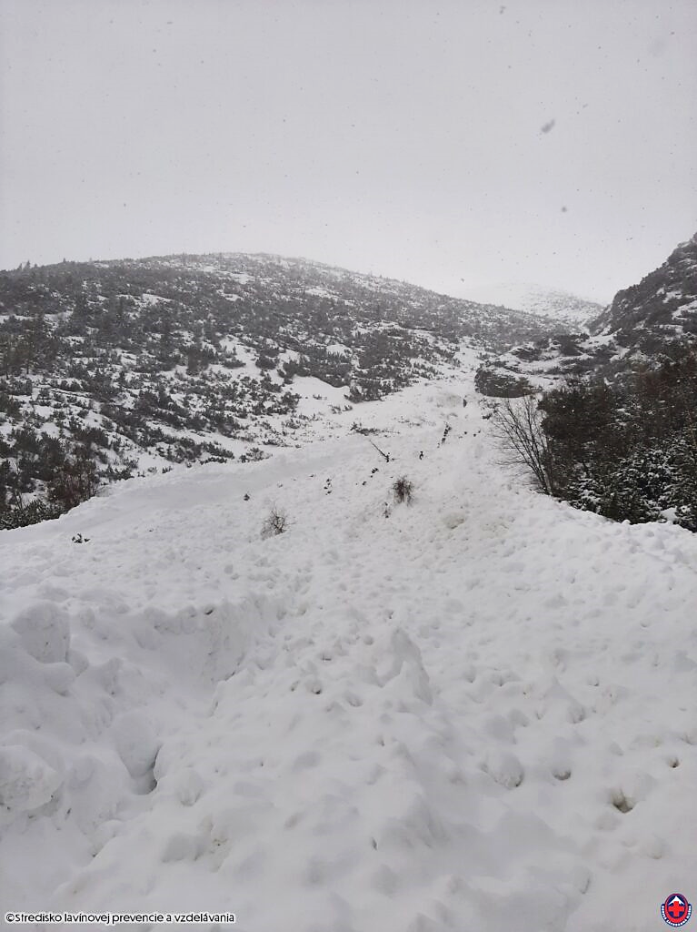
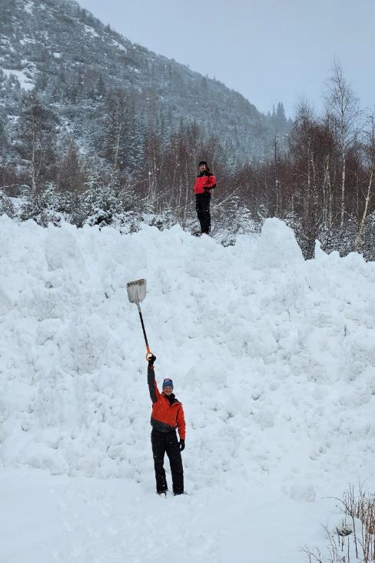
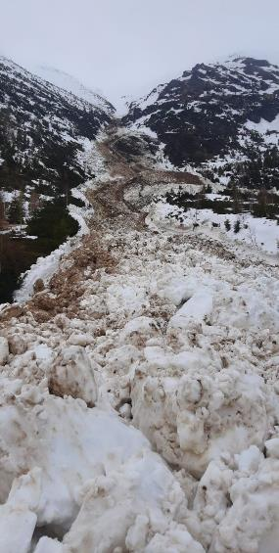
March 25, 2009 – Fall of a century-old avalanche in the Žiarska dolina Valley – thickness of the deposit approximately 20 to 30 m. Damage to the energy infrastructure of the chalet and the SLP weather station.
February 24, 2026, spontaneous, full depth avalanche from Príslop, Žiarska dolina. Source: HZS
17.4.2023 (afternoon) Full depth avalanche in Žiarska dolina (Photo: HZS)
An avalanche broke out from under Príslop mt. According to mountain rescuers, it hit the access road to Žiarska chata and formed a 3m high deposit.

Slide 6
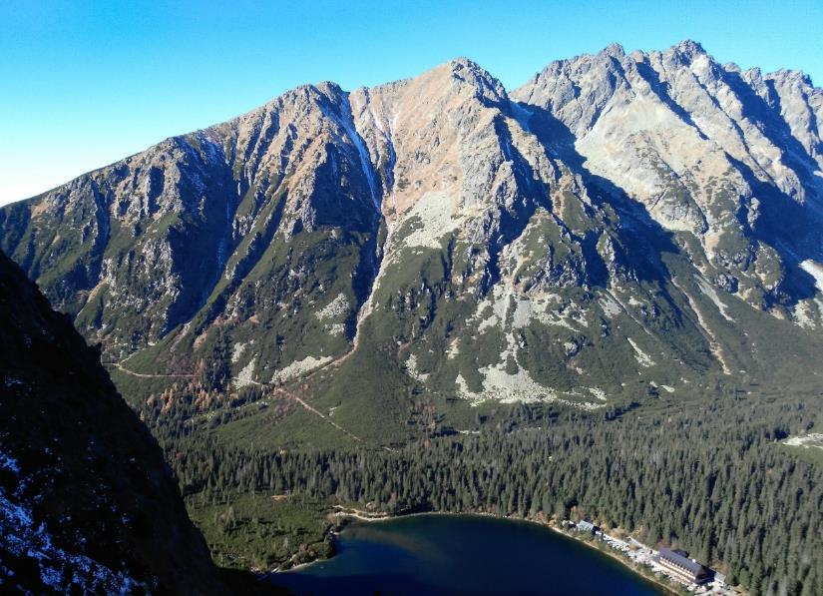
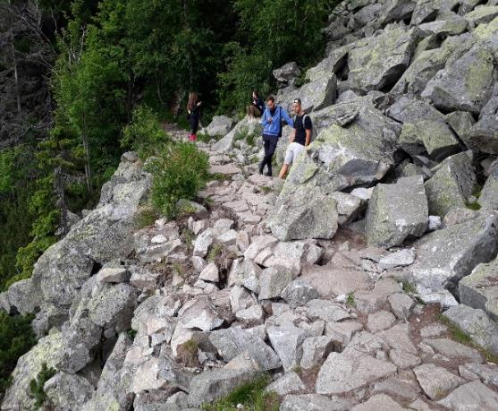
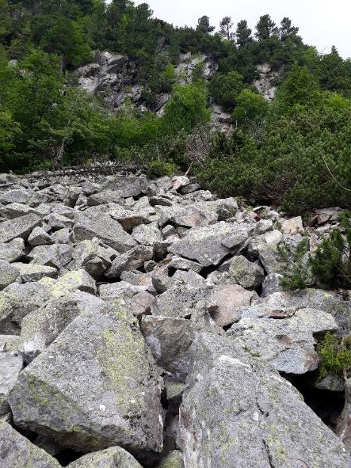
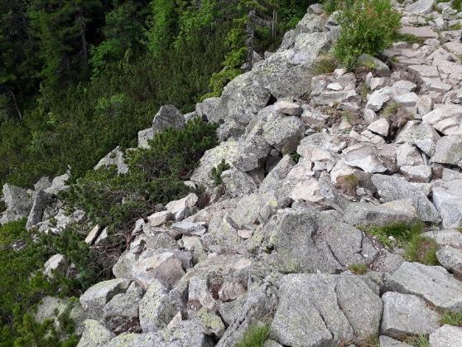
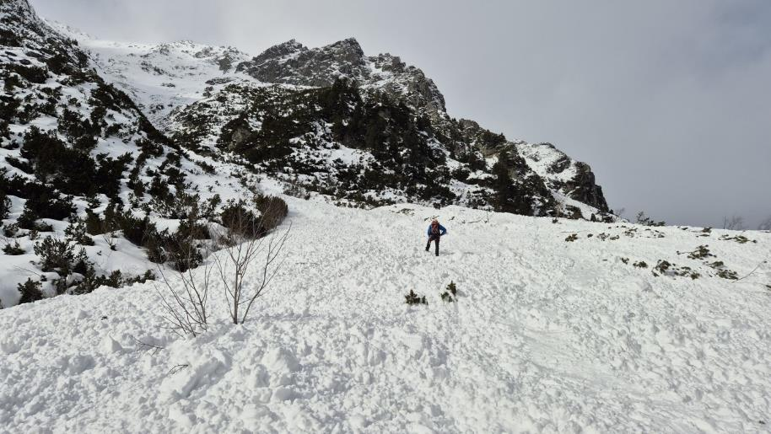
Hiking trail from Štrbské pleso lake to Popradské pleso lake rockfalls and avalanches
avalanche starting zone
PPL
Rockfall source area above the hiking trail.
22.2.2026 – Active avalanche chute under Malá Bašta peak (2228 m alt.) Source: HZS
Rockfall of granodiorite of new blocks above the hiking trail between Štrbské and Popradské pleso. Photo: J. Hreško, 20. 6. 2018

Slide 7
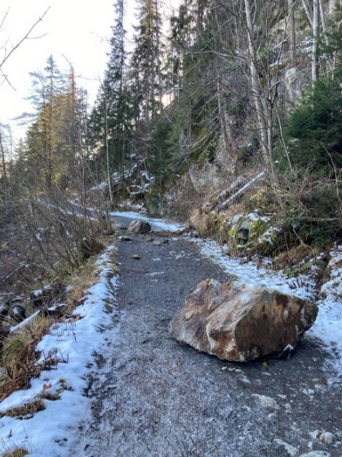
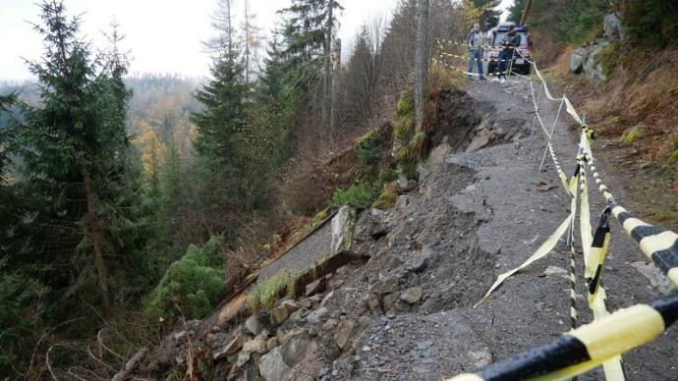
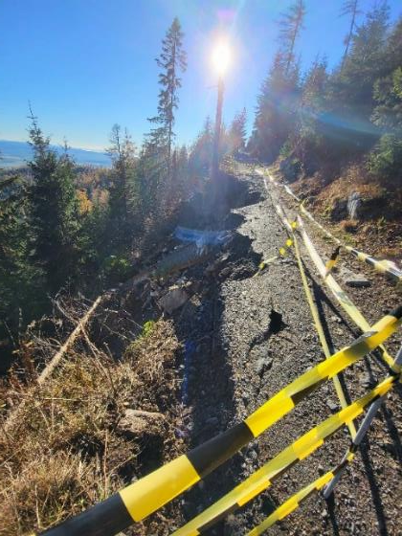
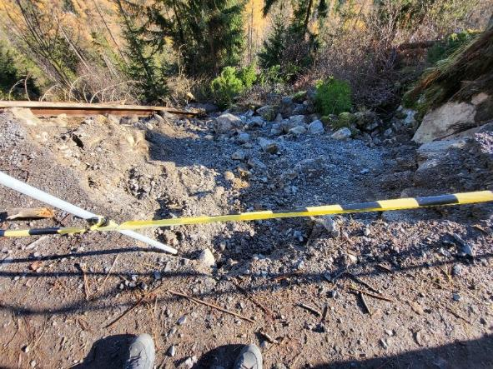
Studená valley (HZC)
Landslides and rock falls on the turistic trail between Hrebienok center and Zamkovského chata cottage - November 2023)
HZC
Rockfalls at the entrance to Studená valley on the trail near Hrebienok (Photo. J. Hreško, 14.11.2023)

Slide 8
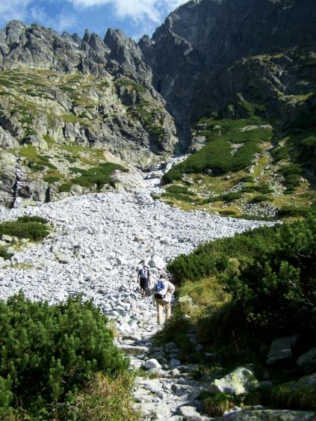
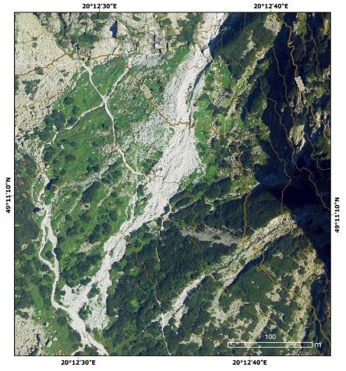
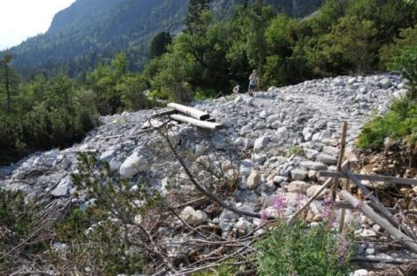
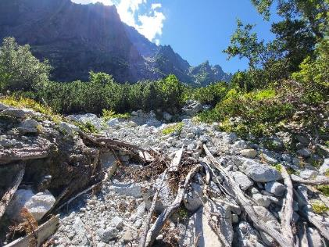
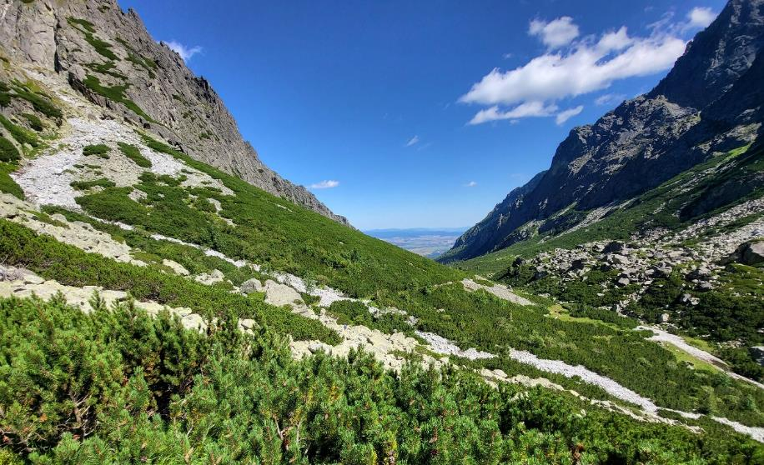
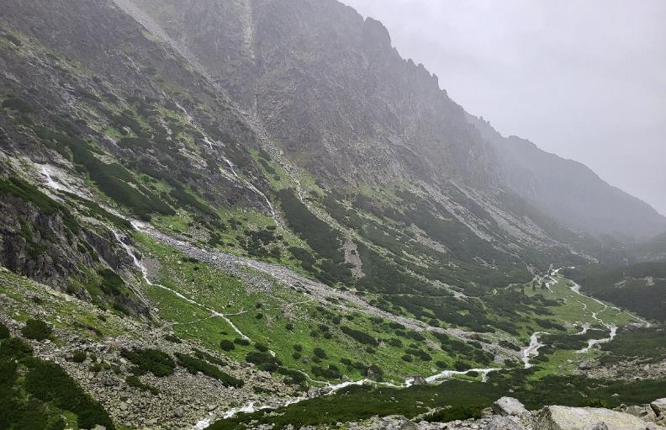
Veľká Studená valley (ZC)
Malá Studená valley (TC)
A massive debris flows in the Veľká and Malá Studená dolina Valley buried a hiking trail and destroyed infrastructure.
12.9.2011
2015
2025
ZC
TC
2025
2025

Slide 9
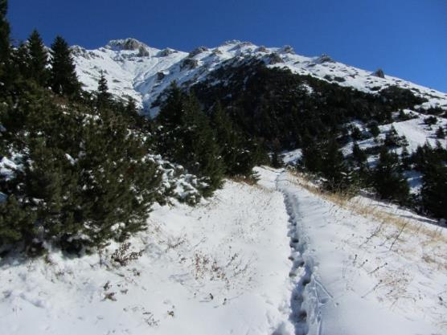
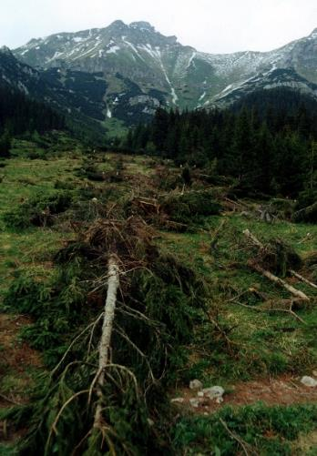
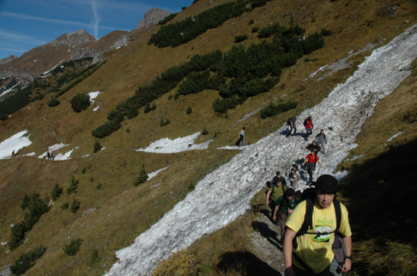
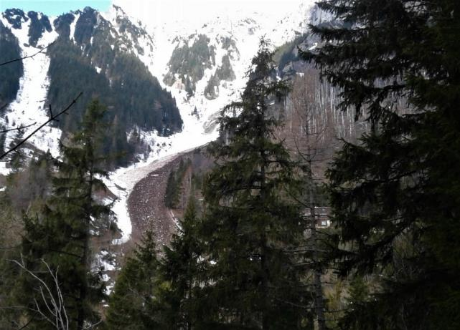
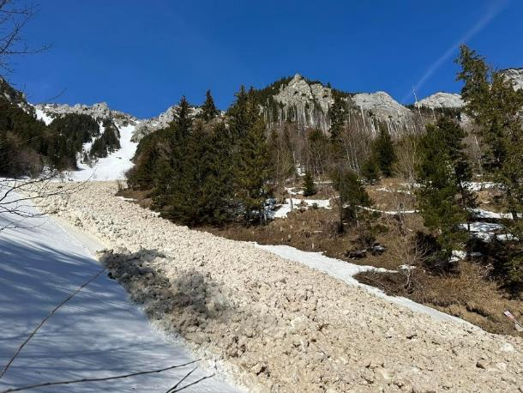
Zadné Meďodoly Valley – Kopské sedlo pass – an important access route to the Belianske and High Tatras from the north.
The most frequent and fastest access for Polish tourists in the Slovak part of the Tatras.
KP
Zadné Meďodoly Valley – a collapse after an avalanche in March 2003 – a gully below Havran, 2151 m a.s.l. (Photo: J. Hreško)
14.10.2008 – Belianske Tatry Mts. – Zadné Meďodoly Valley – avalanche site after the avalanche from early October 2008 (Photo: J. Hreško)
24.10.2009 –Zadné Meďodoly Valley and the Kopské sedlo pass area after early October snowfall with the possibility of radiation avalanches (Photo: J. Hreško)
DOLINA SIEDMYCH PRAMEŇOV VALLEY (Belianské Tatry Mts., SE slope)
PC
A huge avalanches crossing a year-round hiking trail on the right side of Plesnivec cottage - 8.4. 2018 (Left photo: J.Ksiažek) and 19.3. 2023 (Right: J. Matava)
In April 2009, mountain rescuers managed to find a pair of Polish tourists after six days of searching. The avalanche that buried them broke off from the Bujačí vrch massif and occurred in the Valley of the Seven Springs near the Plesnivec cottage.

Slide 10
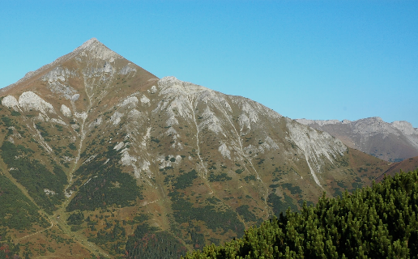
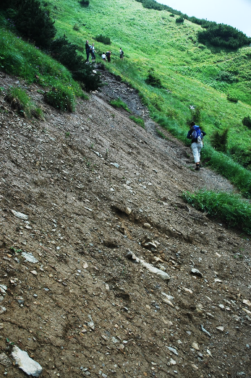
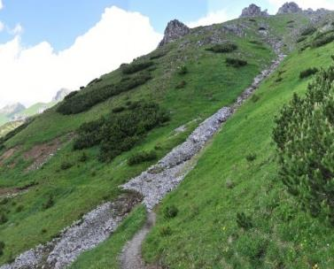
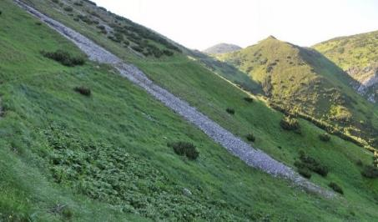
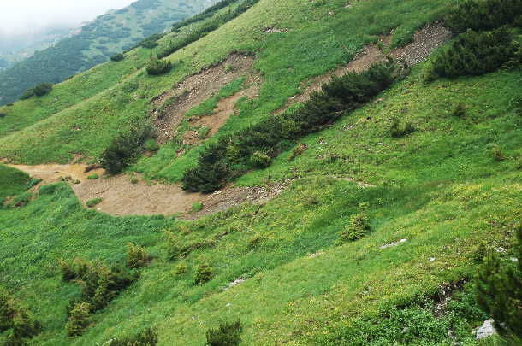
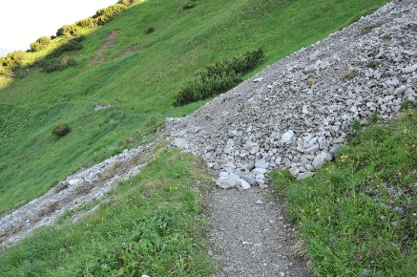
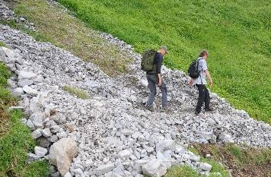
Zadné Meďodoly valley (KP)
The most frequent occurrence of debris flows and debris-mud flows is concentrated on parts of trails that cross gullies and juvenile valleys on slopes, especially in the area of ​​occurrence of mesozoic sedimentary rocks with a large production of fragmental material (Belianske Tatras and Western Tatras).
In the context of climate change, the impact of the cumulative effect of avalanches, debris flows and landslides is increasing, especially in the Belianske Tatras area, both on slopes in the southern and northern sectors of exposure.
KP
Shallow landslides of the soil-weathering mantle removed the vegetation cover and completely destroyed the tourist trail on the SW slope of the Belianske Tatras, not far from the Kopské sedlo pass
(Zadné Meďodoly Valley, June 2009).
2.7.2016
(Photos: J. Hreško)
2009

Slide 11
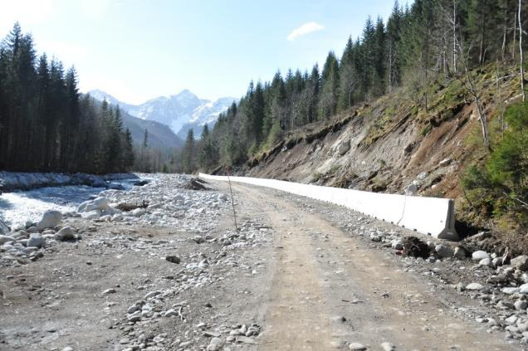
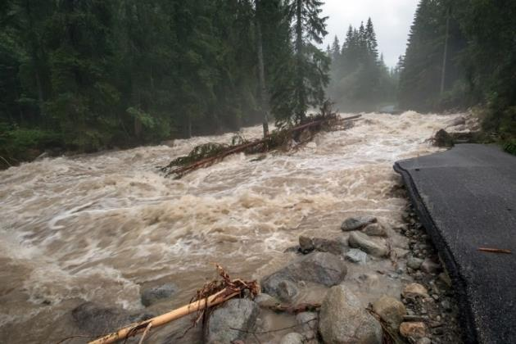
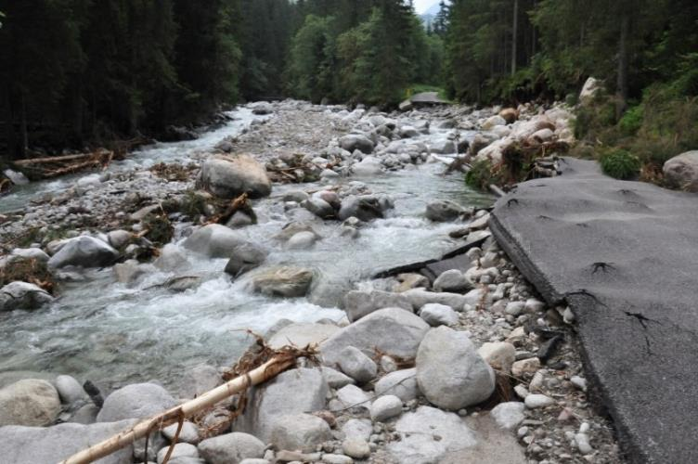
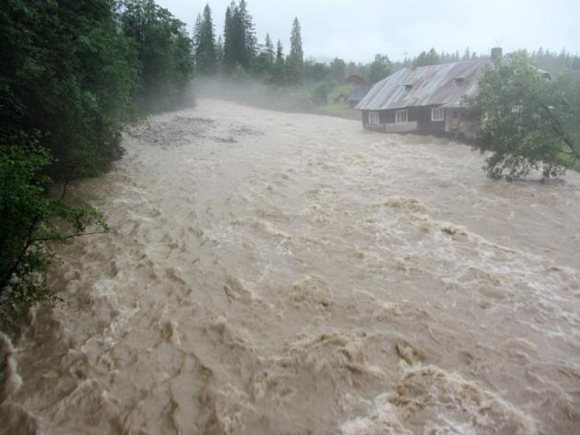
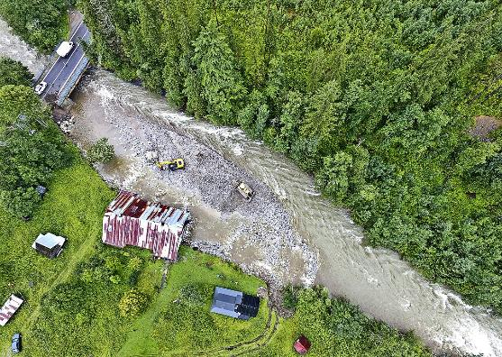
Flash floods on important tourist routes – Javorová dolina valley - 2018
during road reconstruction 30.8.2018
(Photo J. Hreško)
Javorinka creek (Javorová dolina Valley) during the flood - 19.7.2018 (Photo M. Tobis)
after flood - 24.7.2018 (Photo J. Hreško)
Erosion-accumulation activity of the Javorinka stream in front of the bridge in Podspády – 2018 (Source: TANAP)

Slide 12
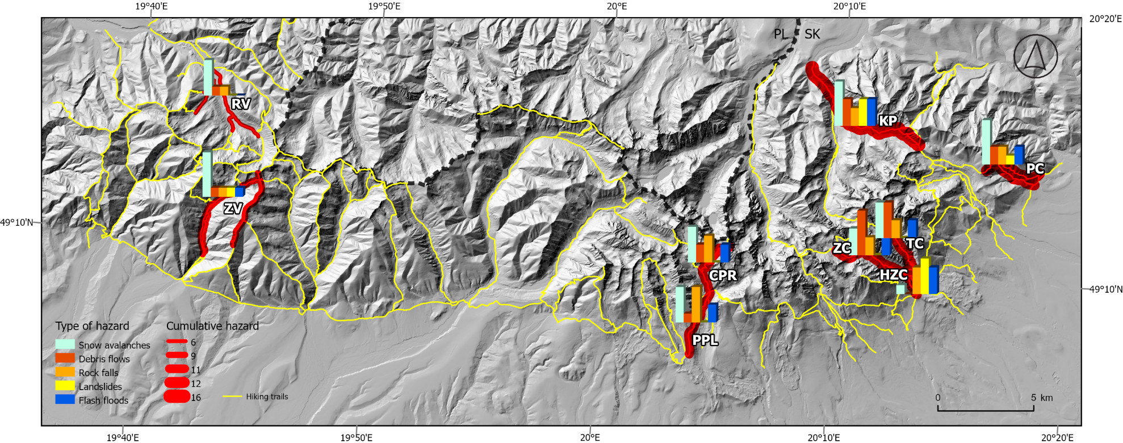
Location and natural hazard values of the study areas in the Tatras
Some results:
endangered both in summer and winter
cumulative effect of processes – higher level of hazards
The information about natural hazards should be clearly expressed e.g. in tourist maps etc., as a preventive tool for risk mitigation in the extreme environment of high mountains.

Slide 13
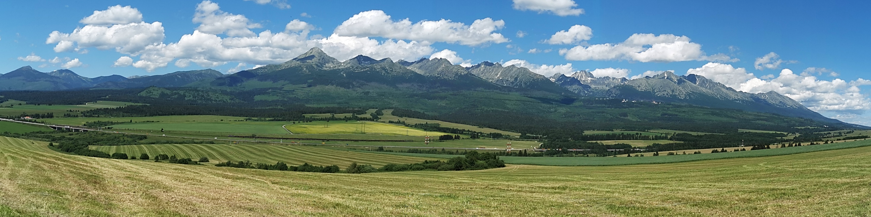
THANK YOU FOR YOUR ATTENTION
Supported by the Project - VEGA-1/0504/25 Classification of archetypes of the Slovak landscape in the context of socio-economic changes and current climate developments

