Slide 1

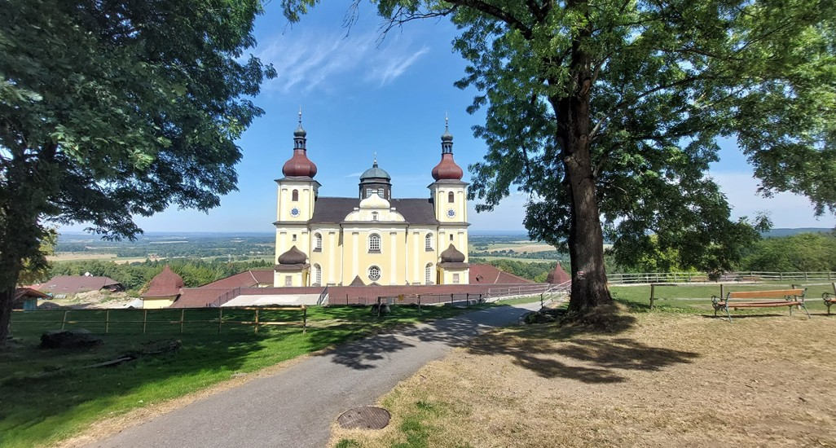
Sustainable natural habitats – the first condition for sustainable tourism
Pavel Cudlín ¹
Jan Purkyt ¹, Vilém Pechanec ², Ondřej Cudlín ¹, Marcela Prokopová ¹, Ahmed Mohammed Ahmed Alhuseen¹, Renata Včeláková ¹
¹Global Change Research Institute of the Czech Academy of Sciences
²Department of Geoinformatics, Faculty of Science, Palacký University Olomouc

Slide 2
Hypotheses
Aim
The aim of this study is to propose a methodological framework for the assessment and monitoring tourism pressure and habitat status in marginalised mountain areas and evaluation an exceeding recreational carrying capacity to recommend measures to support sustainable tourism.
To maintain the attractiveness of the area for tourists, it is necessary to maintain the diversity of the landscape and high biodiversity of their habitats.

Slide 3
Introduction
Mass tourism - characterized by an extreme concentration of tourists in one place and defined by the volume of tourists compared to the concerned territory and to the local population density (Theng et al., 2015)
  Hard tourism - characterized by the comfort and passivity of passengers. Tourists are not interested in cultural enrichment from their hosts; on the contrary, they try to push their habits abroad (Flekalová, 2015).
Overtourism – a situation in which tourist numbers at a destination exceed its carrying capacity, negatively affecting both the quality of resident life and visitor experiences, and the condition of physical environment, including natural and cultural heritage (Dodds & Butler, 2019; Milano et al., 2019).
Sustainable tourism - tourism that takes full account of its current and future economic, social and environmental impacts, addressing the needs of visitors, the industry, the environment and host communities (UNEP et UNWTO, 2005).
Ecotourism - a sustainable form of natural resource-based tourism that focuses primarily on experiencing and learning about nature, and which is ethically managed to be low-impact, non-consumptive, and locally-oriented (Fennell, 1999).
Recreational carrying capacity - the inherent capacity of the set of ecological, vegetation, cultural and social factors that determine the maximum carrying recreational capacity of an area to provide a recreation experience of high quality to the user (Sowman, 1987).
Notes:
Tvrdý turismus - it is characterized by the comfort and passivity of passengers, manifested by the use of transportation by fast means of transport. Tourists are not interested in cultural enrichment from their hosts, on the contrary, they try to push their habits abroad. No account is taken of the impact on the environment or the energy requirements of travel. (Flekalová, 2015)

Slide 4
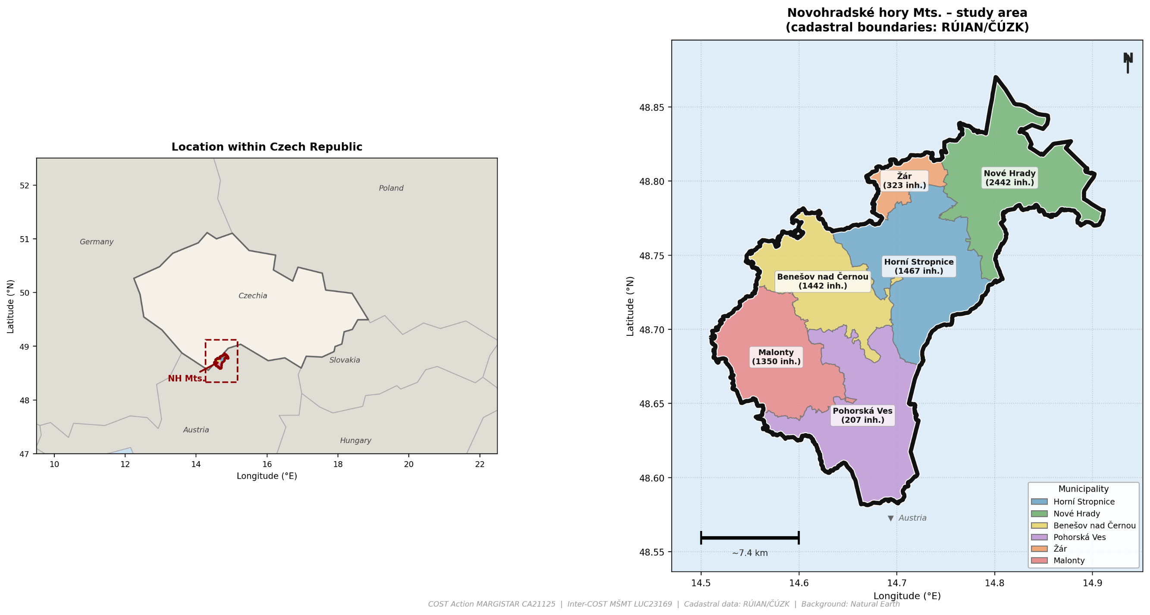
Study area: Novohradské hory Mts.
Area: | 374 km²
Nature Park: | Novohradské hory, 162 km²
Small-scale protected areas: | 1 National Nature Reserve (Žofínský prales) 1 National Nature Monument (Hojná Voda) 4 Nature Reserves 4 Nature Monuments
Natura 2000: | Bird Area Novohradské hory, 90.53 km²
Population characteristics
Natural characteristics
- approx. 7 500 people in 6 municipalities
- largest municipality: Nové Hrady (~2 500 inh.)
- 1 district (České Budějovice), South Bohemia Region
- ancient beech forests and primeval forest (Žofínský prales and Hojná Voda virgin forests)
- rich biodiversity: meadow, wetland and forest habitats
- border landscape with Austria, marginalized area
overlapping with western part of the Landscape Protected Area Třeboňsko
Notes:
Fakta o CHKO Beskydy:
rozloha: 1 160 km2
nadmořská výška: 350 - 1323 m n. m.
vyhlášení: 30. 3. 1973
60 maloplošných zvláště chráněných území: 7 národních přírodních rezervací, 28 přírodních rezervací, 25 přírodních památek
Natura 2000: 1 evropsky významná lokalita, 2 ptačí oblasti
Chráněná krajinná oblast Beskydy je největší CHKO v České republice. Její území představuje přírodovědně a krajinářsky poměrně zachovalý krajinný celek nejvyšších karpatských pohoří na našem území. Rozkládá se při severovýchodní hranici České republiky v členité hornatině Vnějších Západních Karpat
Zdroj: https://beskydy.nature.cz/charakteristika-oblasti
nevím jak přeložit SO ORP – ani na stránkách ČSU to nemají přeložené

Slide 5
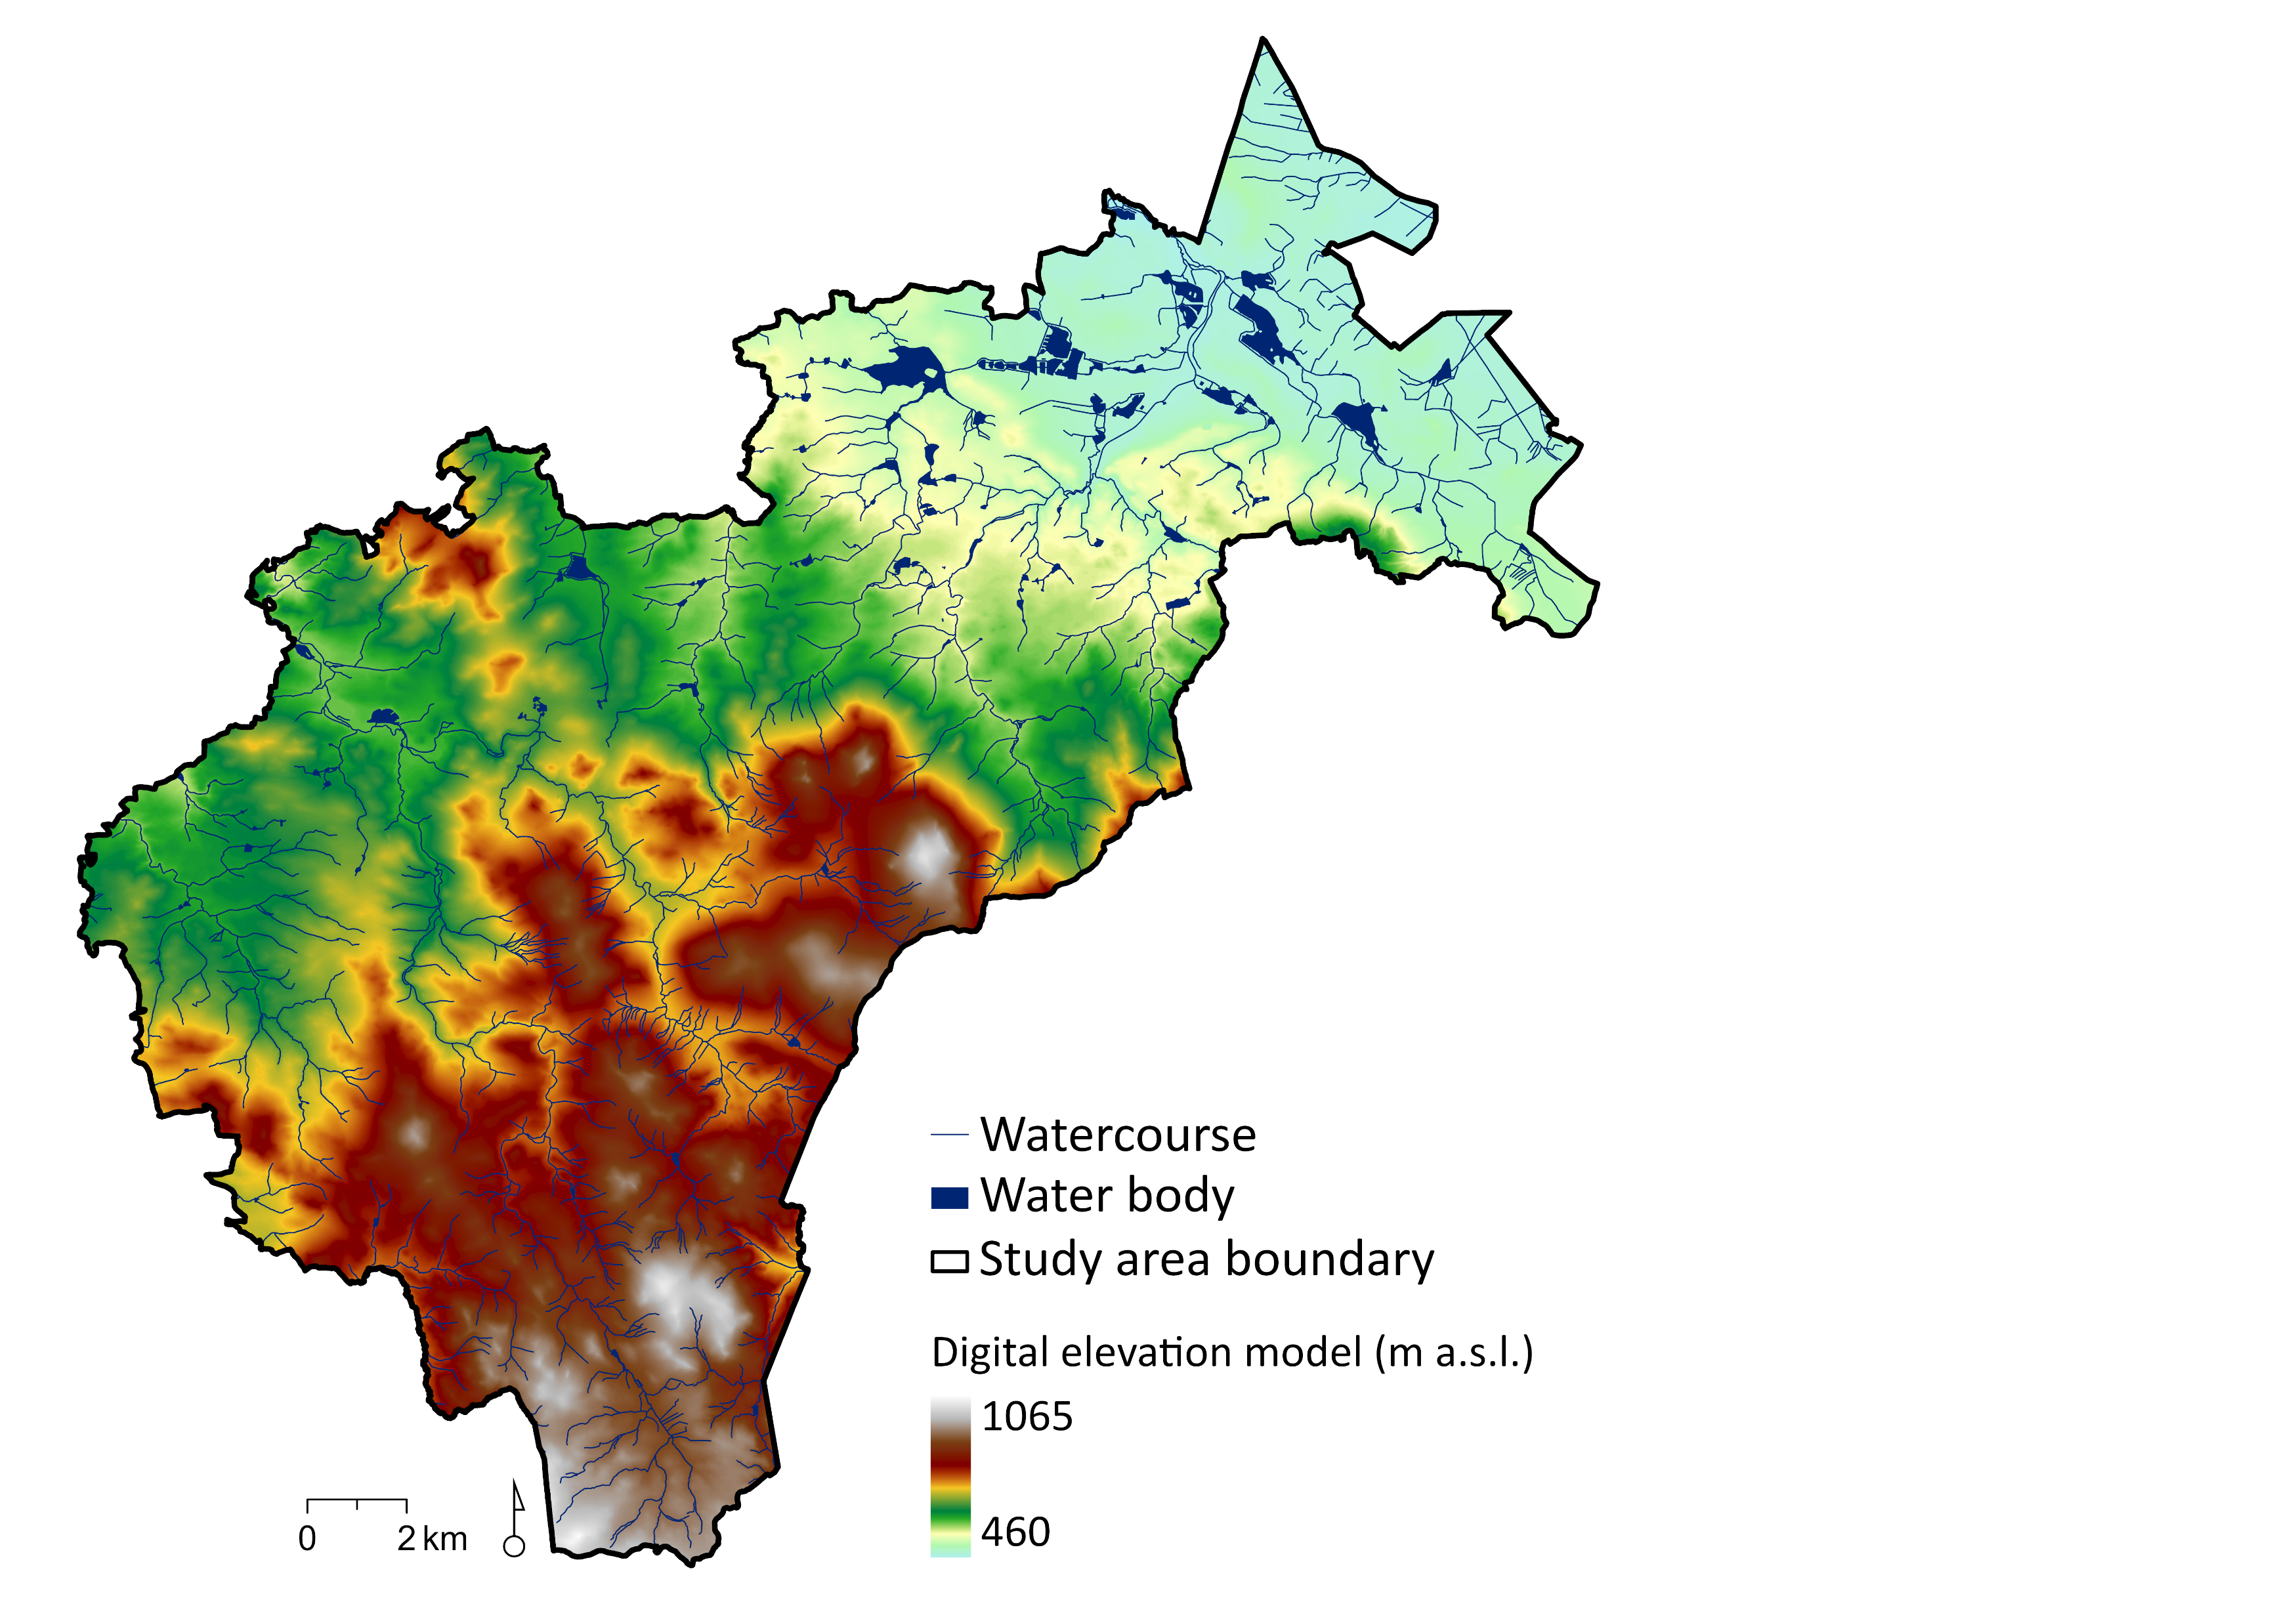
Digital Elevation Model of the Novohradské hory Mts.

Slide 6
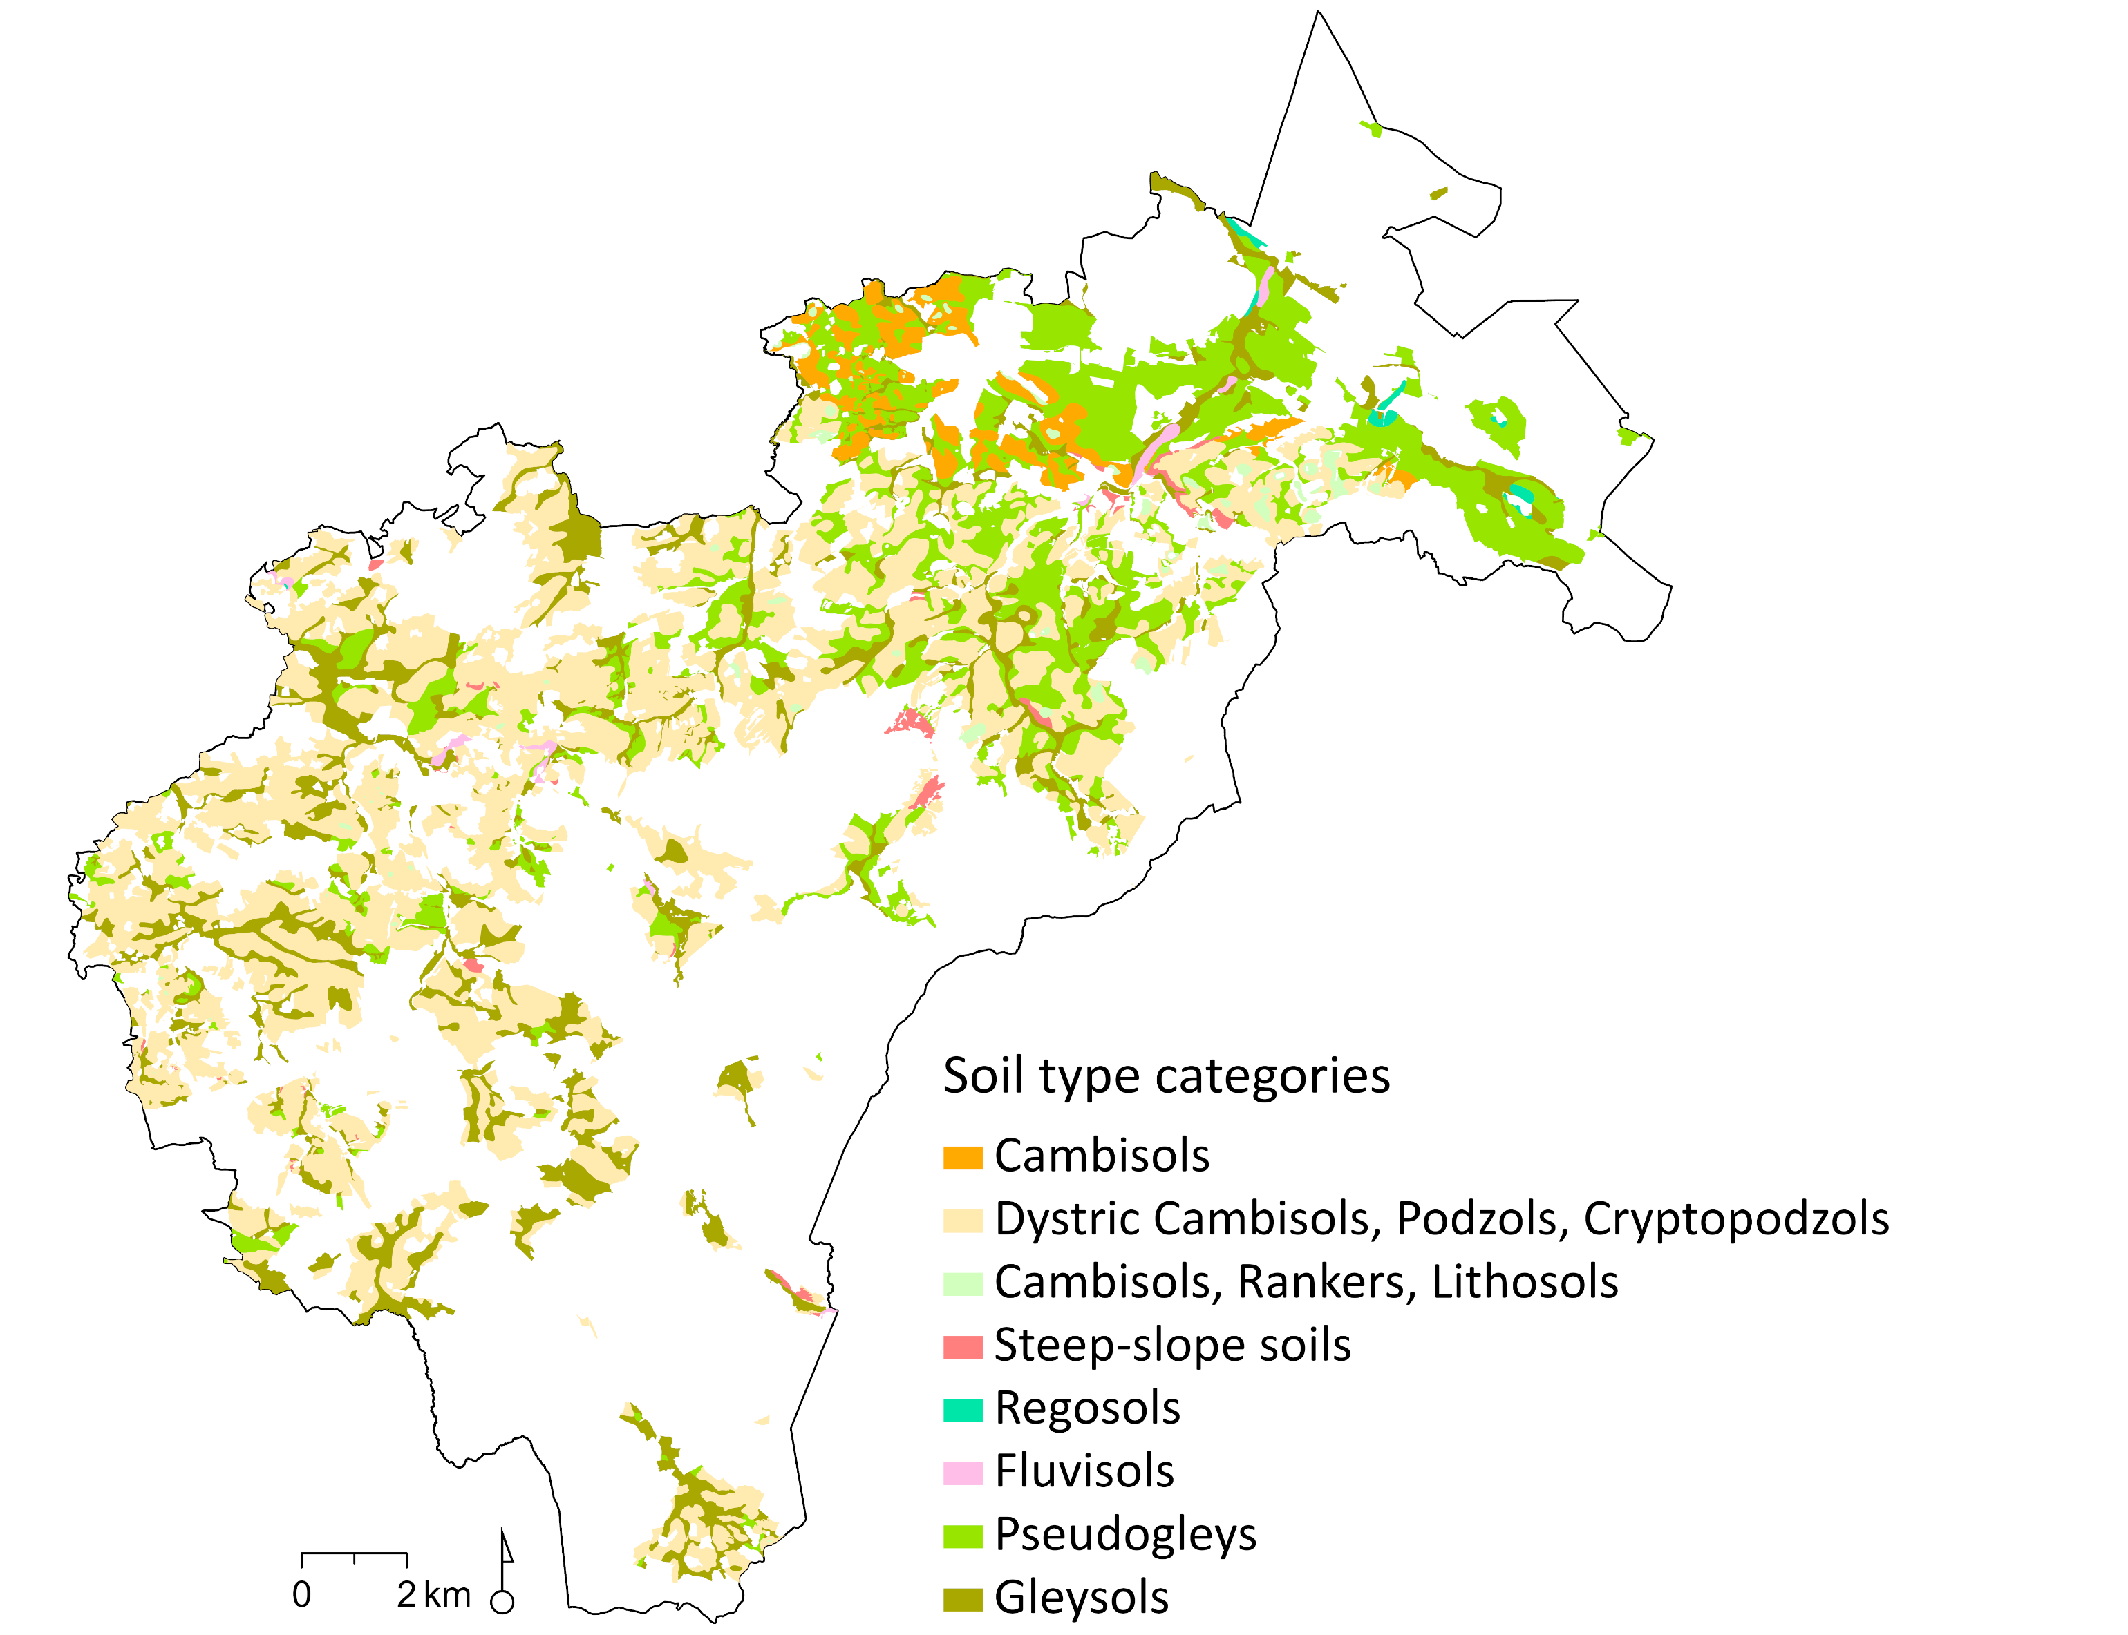
Map of Soil Types in the Novohradské hory Mts.

Slide 7
Problems - natural habitats versus countryside change
Depopulation of marginal mountain areas and abandonment of traditional landscape management (mowing, grazing), leading to the succession of valuable near-natural meadow and wetland habitats
The concentration of large numbers of people can damage the fragile and endangered habitats due to their frequent trampling, noise, leaving trash etc.
In the Novohradské hory Mts. there are a number of forest habitats that need special management for improving their biodiversity and resistance to global change; routine forest management does not support the sustainable use of natural resources in the area.
Commercial pressures on core habitats: non-native fish stocking at Jiřická nádrž and planned Windpark Sandl wind farm at the border with Austria (under transboundary EIA)
Created using ChatGPT and DALL·E, OpenAI, 2024
Created using ChatGPT and DALL·E, OpenAI, 2024

Slide 8
The state of tourism in the Novohradské hory Mts.
Problems:
  Most residents oppose tourism expansion due to increasing litter, noise and disturbance of their tranquility
  Lack of tourism infrastructure to increase the economic contribution of tourists to the area
  Visitor pressure concentrated at a few hotspots (Kraví hora, Hojná Voda, Pohoří na Šumavě); a large part of the area remains little affected by tourists; field type of tourists is widespread almost all over area
  Visitors' reluctance to comply with any restrictions on movement in the nature, even the only one in force today (entry to the NPR Žofínský prales and the PR Hojná voda outside marked paths)
  Pressure for new recreational development without adequate impact assessment (Černé údolí, Šejby, Pohoří na Šumavě)
Notes:
Issues:
Local residents are predominantly sceptical about further tourism development; primary concerns: accumulation of waste and litter left by visitors, disturbance of tranquility and wildlife.
Visitor pressure concentrated mainly at popular summits (Kraví hora) and Hojná Voda; the remainder of the territory shows low visitor numbers; Pohoří na Šumavě is gradually transforming into an exclusive recreational enclave for wealthy visitors.
Non-compliance with regulations by a share of tourists; unauthorised access to sensitive habitats (Žofínský prales NNR surroundings, wetlands, peatbogs).
Pressure for new recreational development without adequate impact assessment (Černé údolí, Šejby, Pohoří na Šumavě).
Commercial pressures on the core of the territory: stocking of non-native fish species for commercial angling at Jiřická nádrž (decimating native fish and amphibian communities) and the planned Windpark Sandl wind farm at the border (currently under transboundary EIA).
Vliv na:
Zarůstání cenných lučních a mokřadních biotopů vlivem úbytku tradičního obhospodařování (sečení, pastva)
Fragmentace stanovišť a vytlačování velkých šelem (rys, vlk) z jádrových území; ohrožení hnízdišť a migračních koridorů citlivých druhů (čáp černý, jeřábek lesní, tetřívek)
Ohrožení kvality pitné vody: území NH tvoří 60 % povodí vodárenské nádrže Římov; riziko zhoršení kvality vody vlivem nové zástavby a nedostatečné kapacity čištění odpadních vod
Nevratná ztráta klidu a krajinného rázu jako hlavní turistické hodnoty regionu (hrozba Windpark Sandl, developerský tlak)

Slide 9
  Consequences:
  Fragmentation of habitats and displacement of large carnivores (lynx, wolf) from core areas; threats to nesting sites and migration corridors of sensitive species (black stork, black grouse)
  Risk to drinking water quality: the NH territory accounts for 60% of the catchment area of the Římov reservoir; increased risk of water quality deterioration from new built development and insufficient wastewater treatment capacity
  Irreversible loss of tranquility and landscape character as the region's primary tourism asset (Windpark Sandl project, development pressure)

Slide 10
Methods
The framework integrates three complementary analytic tools:
The modified CZ-GLOBIO3 model to assess biodiversity endangerment
A land use change analysis based on CORINE data 1990-2018 and 2006–2018 to identify development risks
The Habitat Valuation Method (HVM) to evaluate habitat quality based on eight ecological criteria and its individual habitat valuation (Seják et al. 2018)
Next information was obtained in the frame of participation research with relevant stakeholders (local government, state nature protection, municipalities, non-government organisations, farmers, foresters.

Slide 11
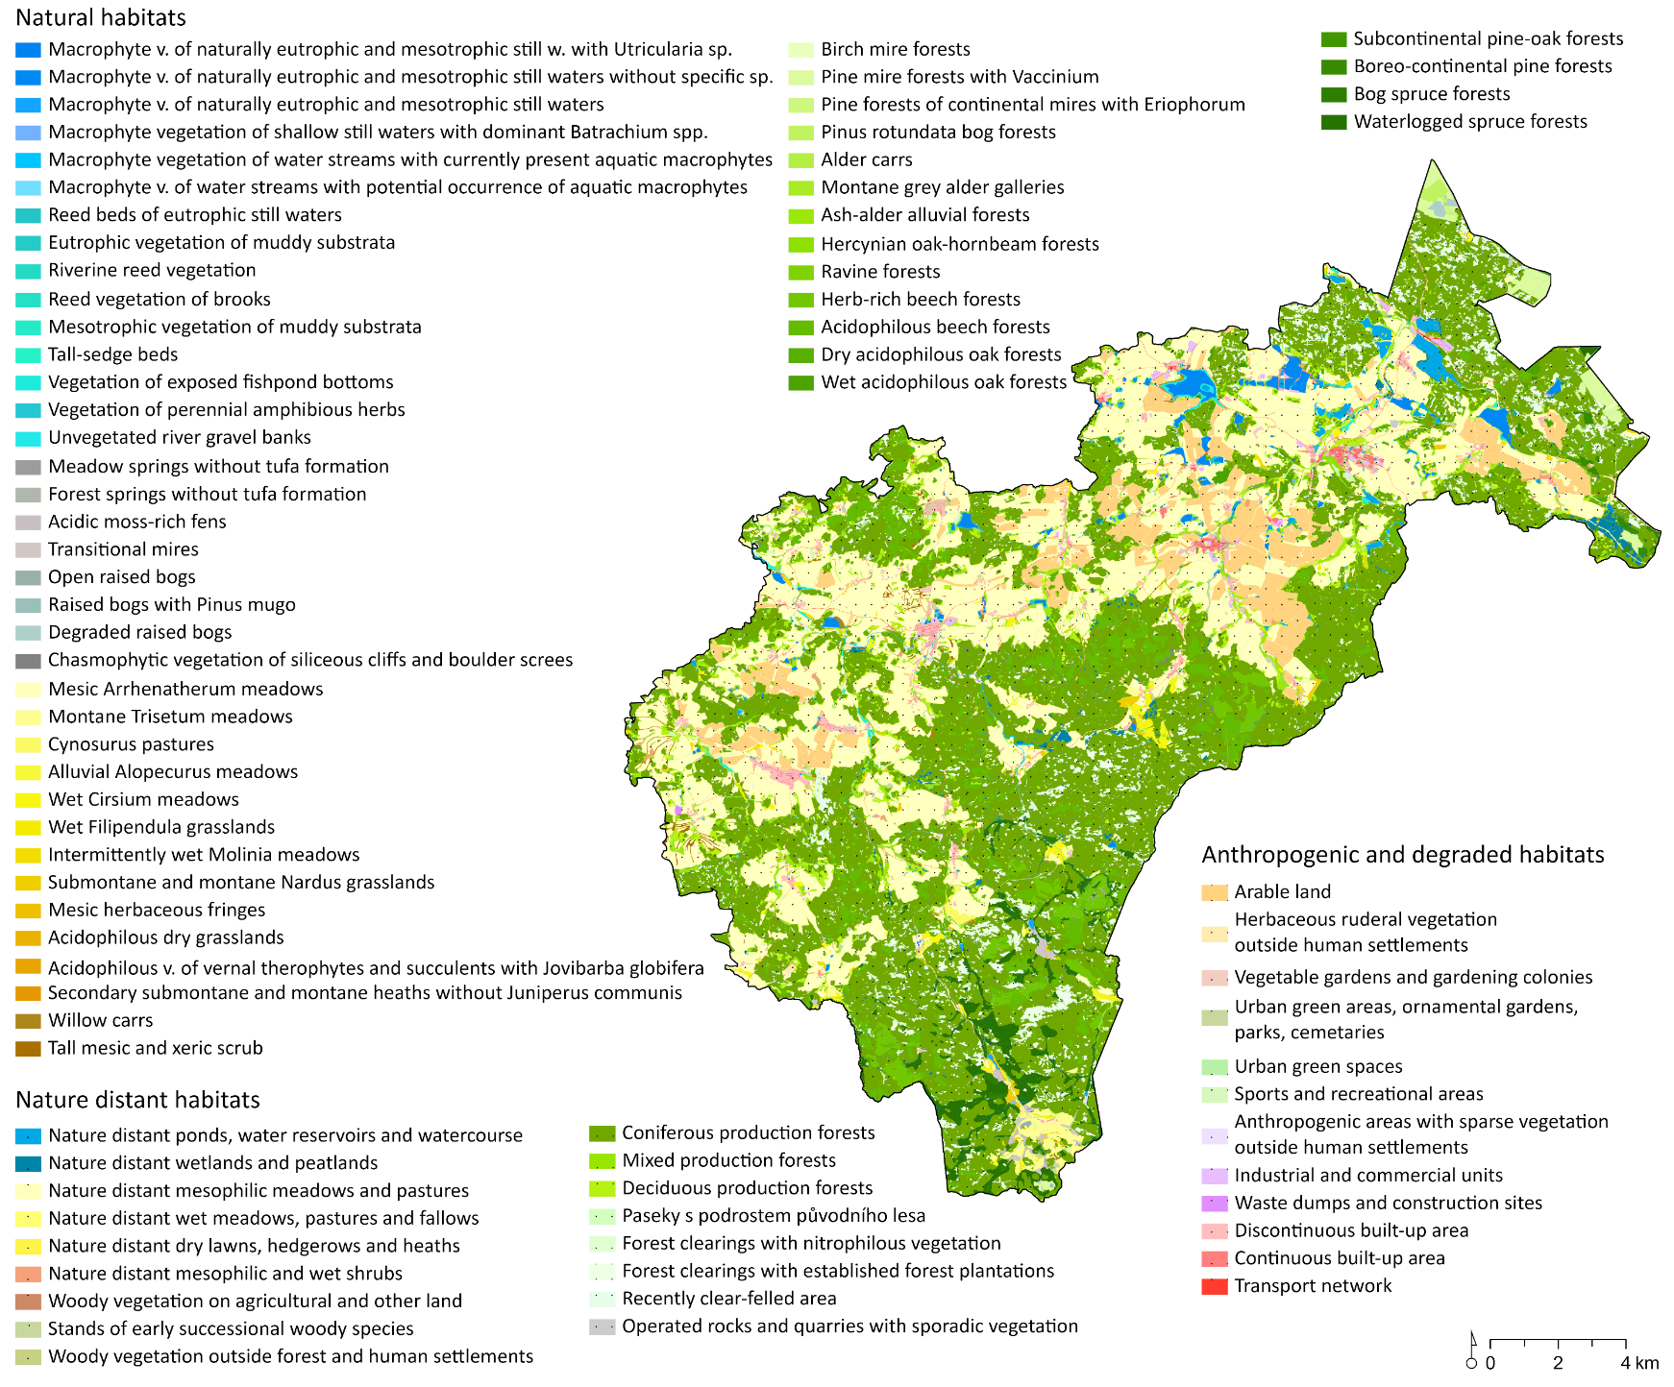
Detailed Habitat Layer
The Detailed Habitat Layer (DHL) forms the core spatial dataset underlying the CZ-GLOBIO3 model. It integrates the Habitat Mapping Layer of the Czech Republic at 1:10,000 scale, containing 168 natural habitats (Chytrý et al. 2010) and 45 non-natural habitats (Seják et al. 2018), supplemented by LPIS 2022, ZABAGED 2023, OpenStreetMap 2022, and another 6 data layers from Copernicus Land Monitoring Service, Czech Forestry Institute, and Department of Geoinformatics, UPOL.

Slide 12
Model GLOBIO 3 - Global Biodiversity model
The GLOBIO 3 model (Alkemade et al. 2009) estimates the threat to biodiversity - the potential loss of species in a habitat with a reduced degree of naturalness due to human activities using the MSA indicator (mean species abundance).
The value of the indicator ranges from 0 to 1 (0-100%). We converted the GLOBIO3 model to CZ-GLOBIO3 by adjusting global to local scales and using habitat quality and naturalness data instead of worldwide species occurrence data.
An MSA value of 1 corresponds to the conservation of all native species in undisturbed ecosystems, and an MSA value of 0 reflects a completely altered artifcial ecosystem without native species.
we work with four main drivers that have direct impact on species diversity: (i) land use (MSA_LU), (ii) infrastructure development (MSA_I); (iii) fragmentation (MSA_F) and (iv) N critical load exceedance.

Slide 13
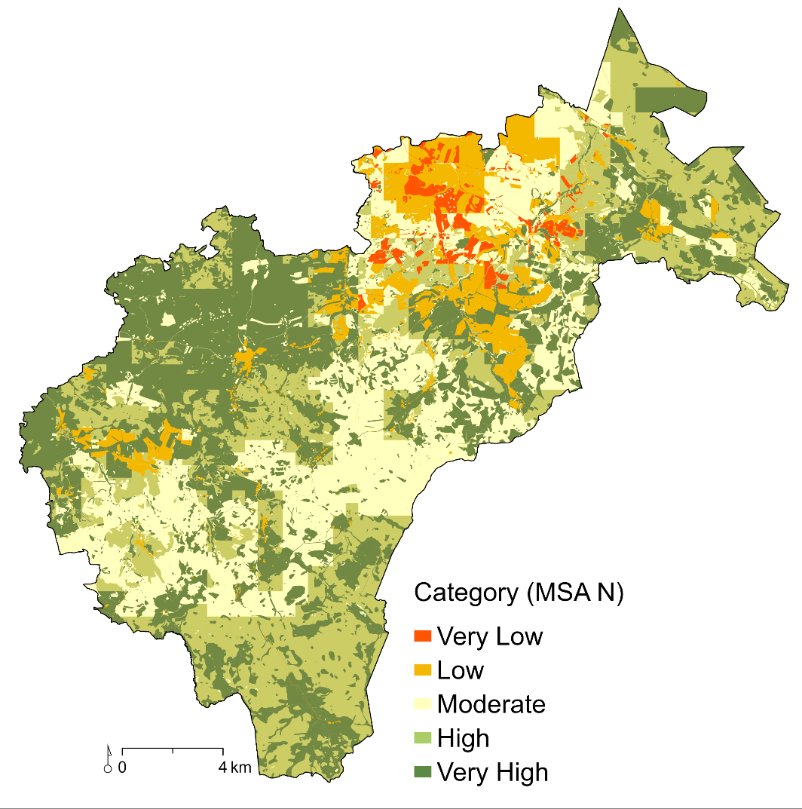
MSA Category for the Novohradské hory Mts.
Category (MSA N)

Slide 14
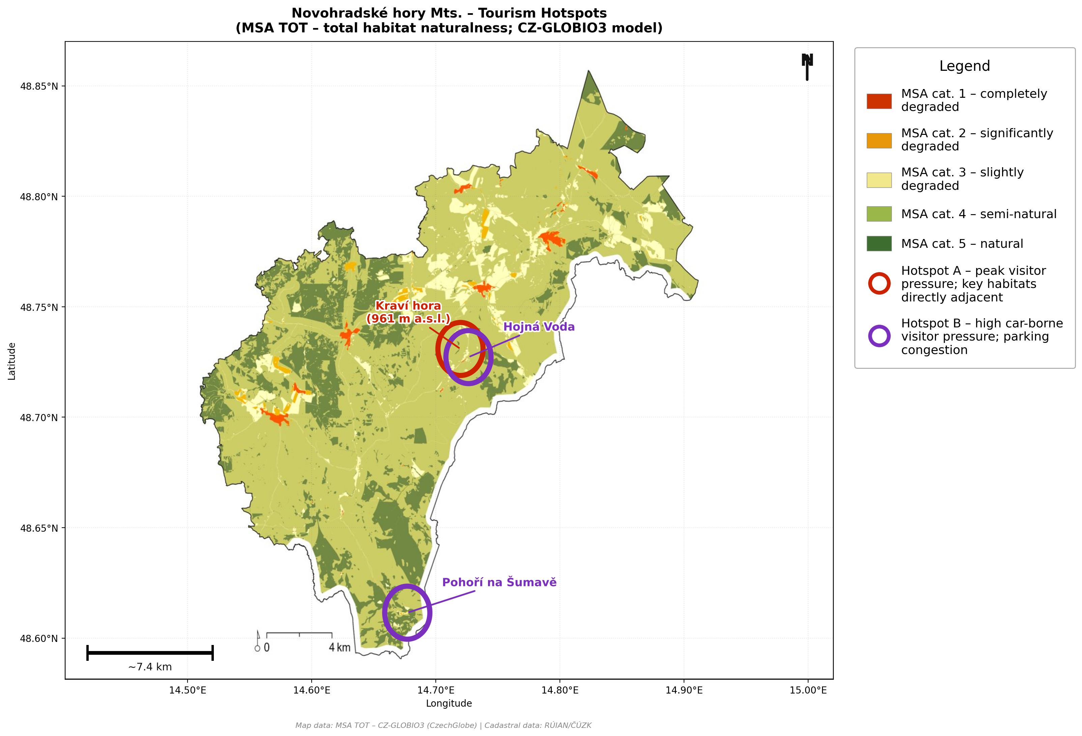
Hotspots versus GLOBIO model results
Hotspots – where there is the greatest pressure of tourism due to the number of visitors (red circle) or high car-borne visitor pressure; parking congestion (purple circle) and the presence of valuable habitats.

Slide 15
Land use change analysis
Land use change risk is determined based on changes in land-use categories within 500 × 500 m grid cells, using CORINE Land Cover (CLC) maps from 1990 - 2018 and 2006 - 2018.
The CLC categories are grouped into three classes according to the degree of built-up intensity: (P) non-built-up, (T) transitional (discontinuous urban fabric up to 10% coverage), and (U) built-up areas.

Slide 16
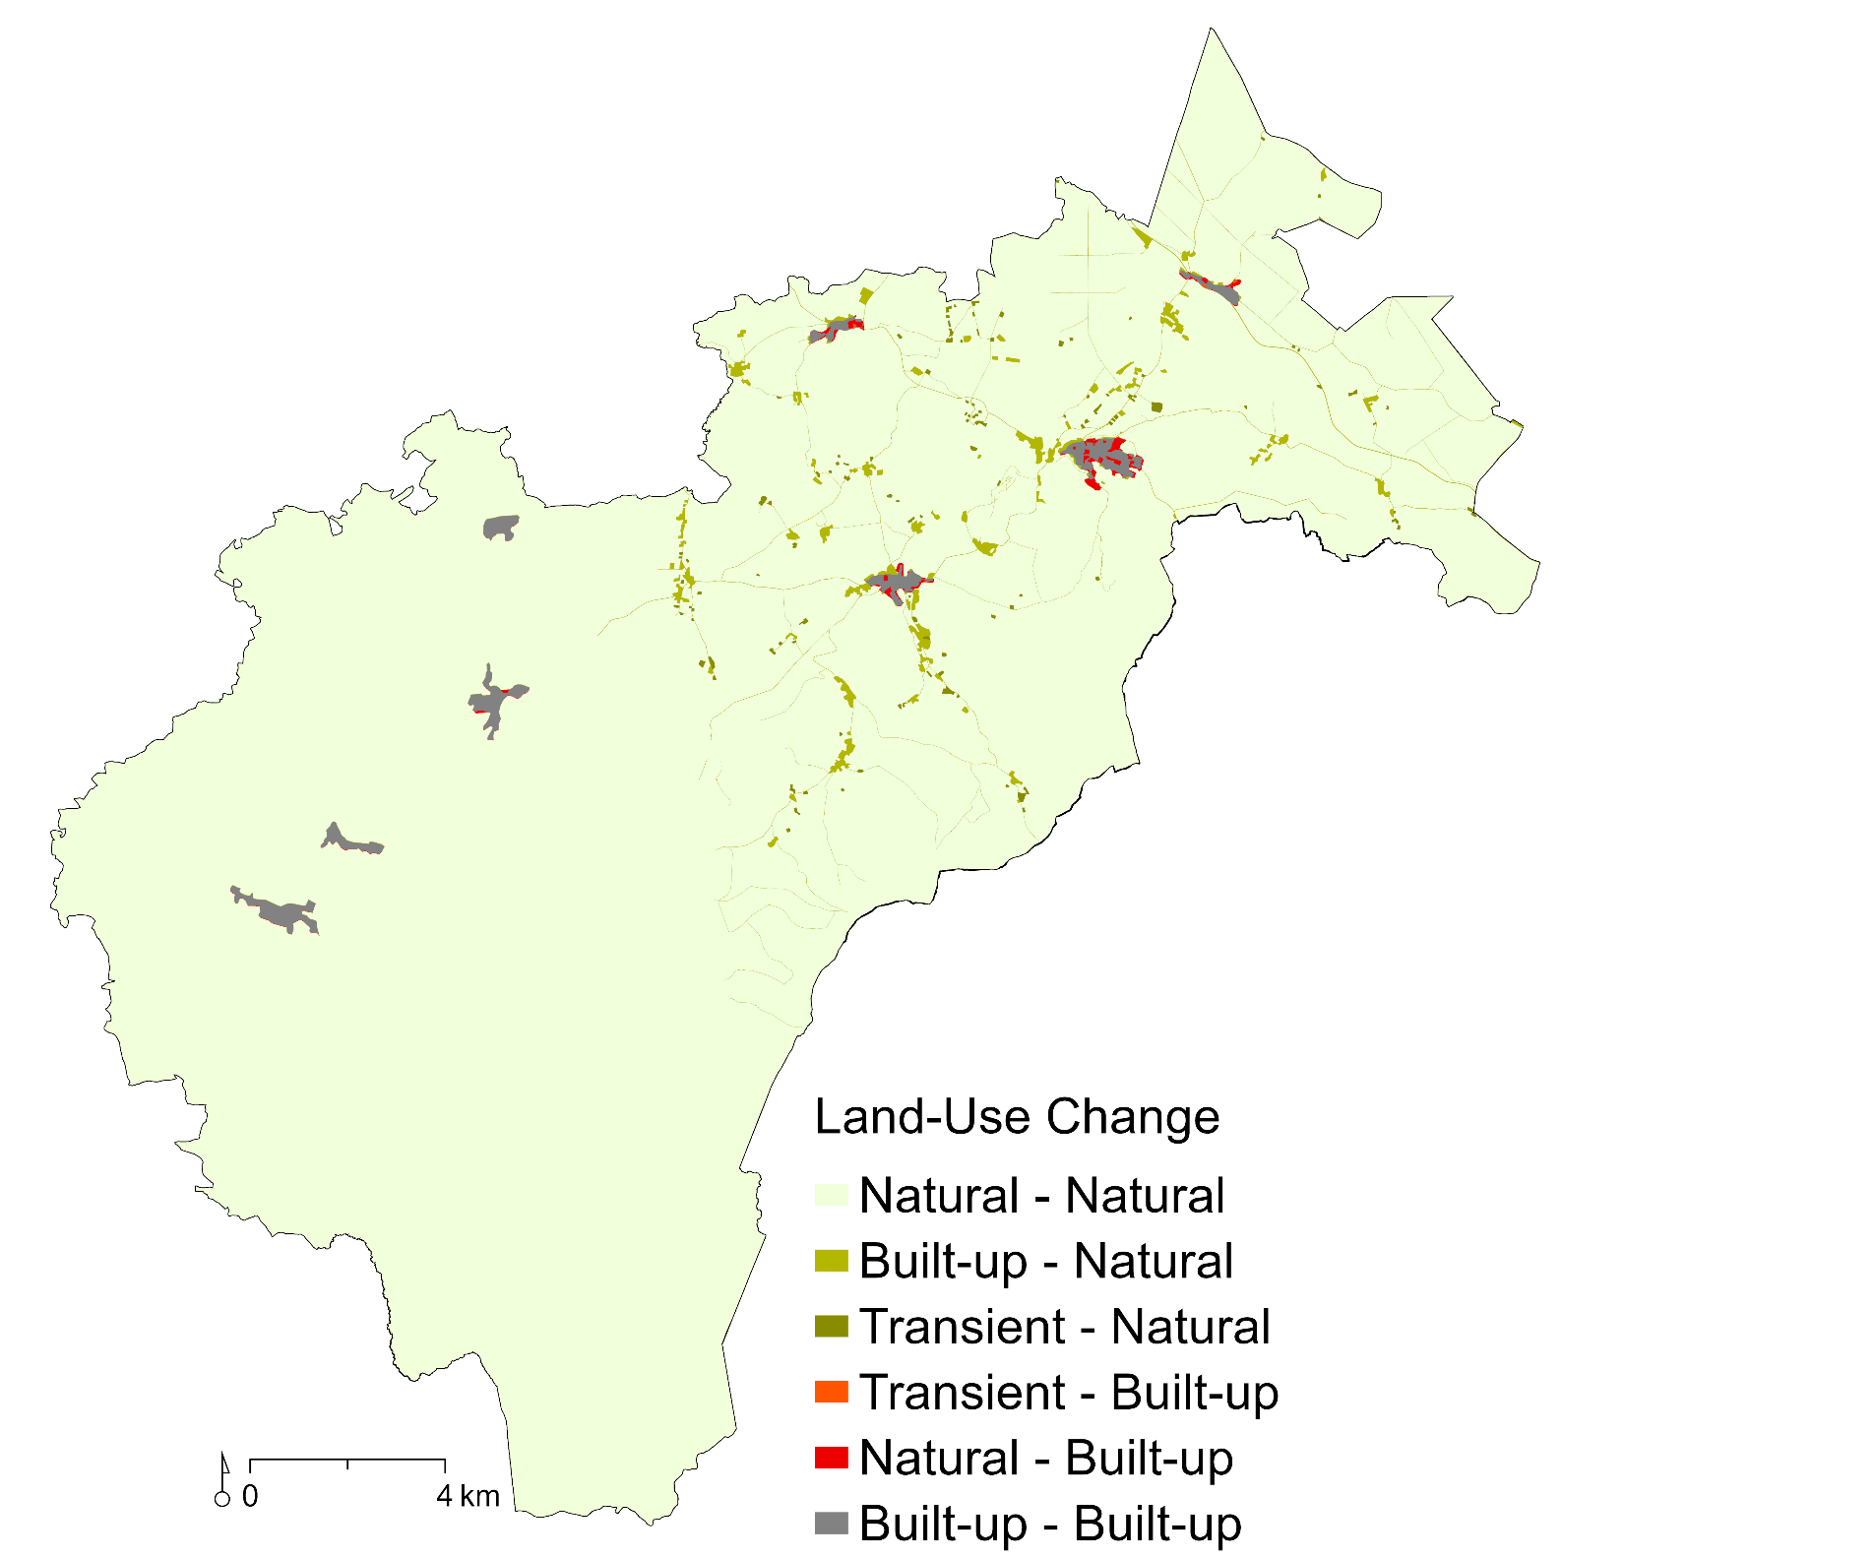
Land-use Change
1990 - 2018

Slide 17
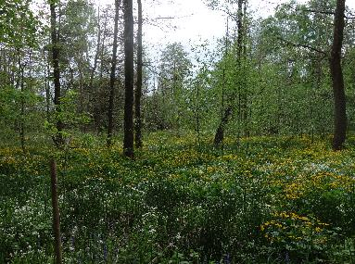
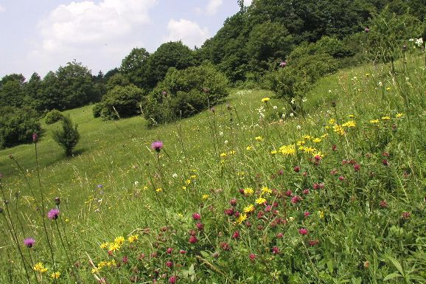
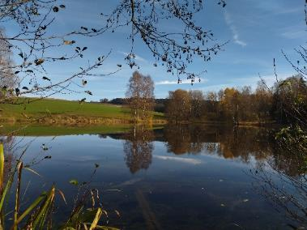
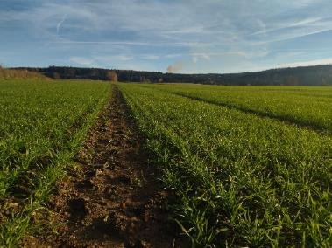
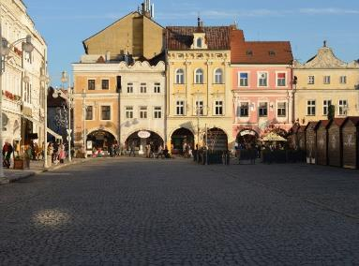
Habitat Valuation Method (HVM)
All habitats are divided into five groups according to their naturalness, from natural to anthropogenic habitats
Natural habitats – (forests, wetlands, peat bog)
Semi-natural habitats – (meadows)
Slightly degraded habitats (degradaded meadows)
Strongly degraded habitats (arable land)
Totally degraded habitats (built-up area)

Slide 18
Expert evaluation of habitat types
Relative value of habitat types is calculated from eight characteristics
that represent ecological quality and rarity (endangereness).

Slide 19
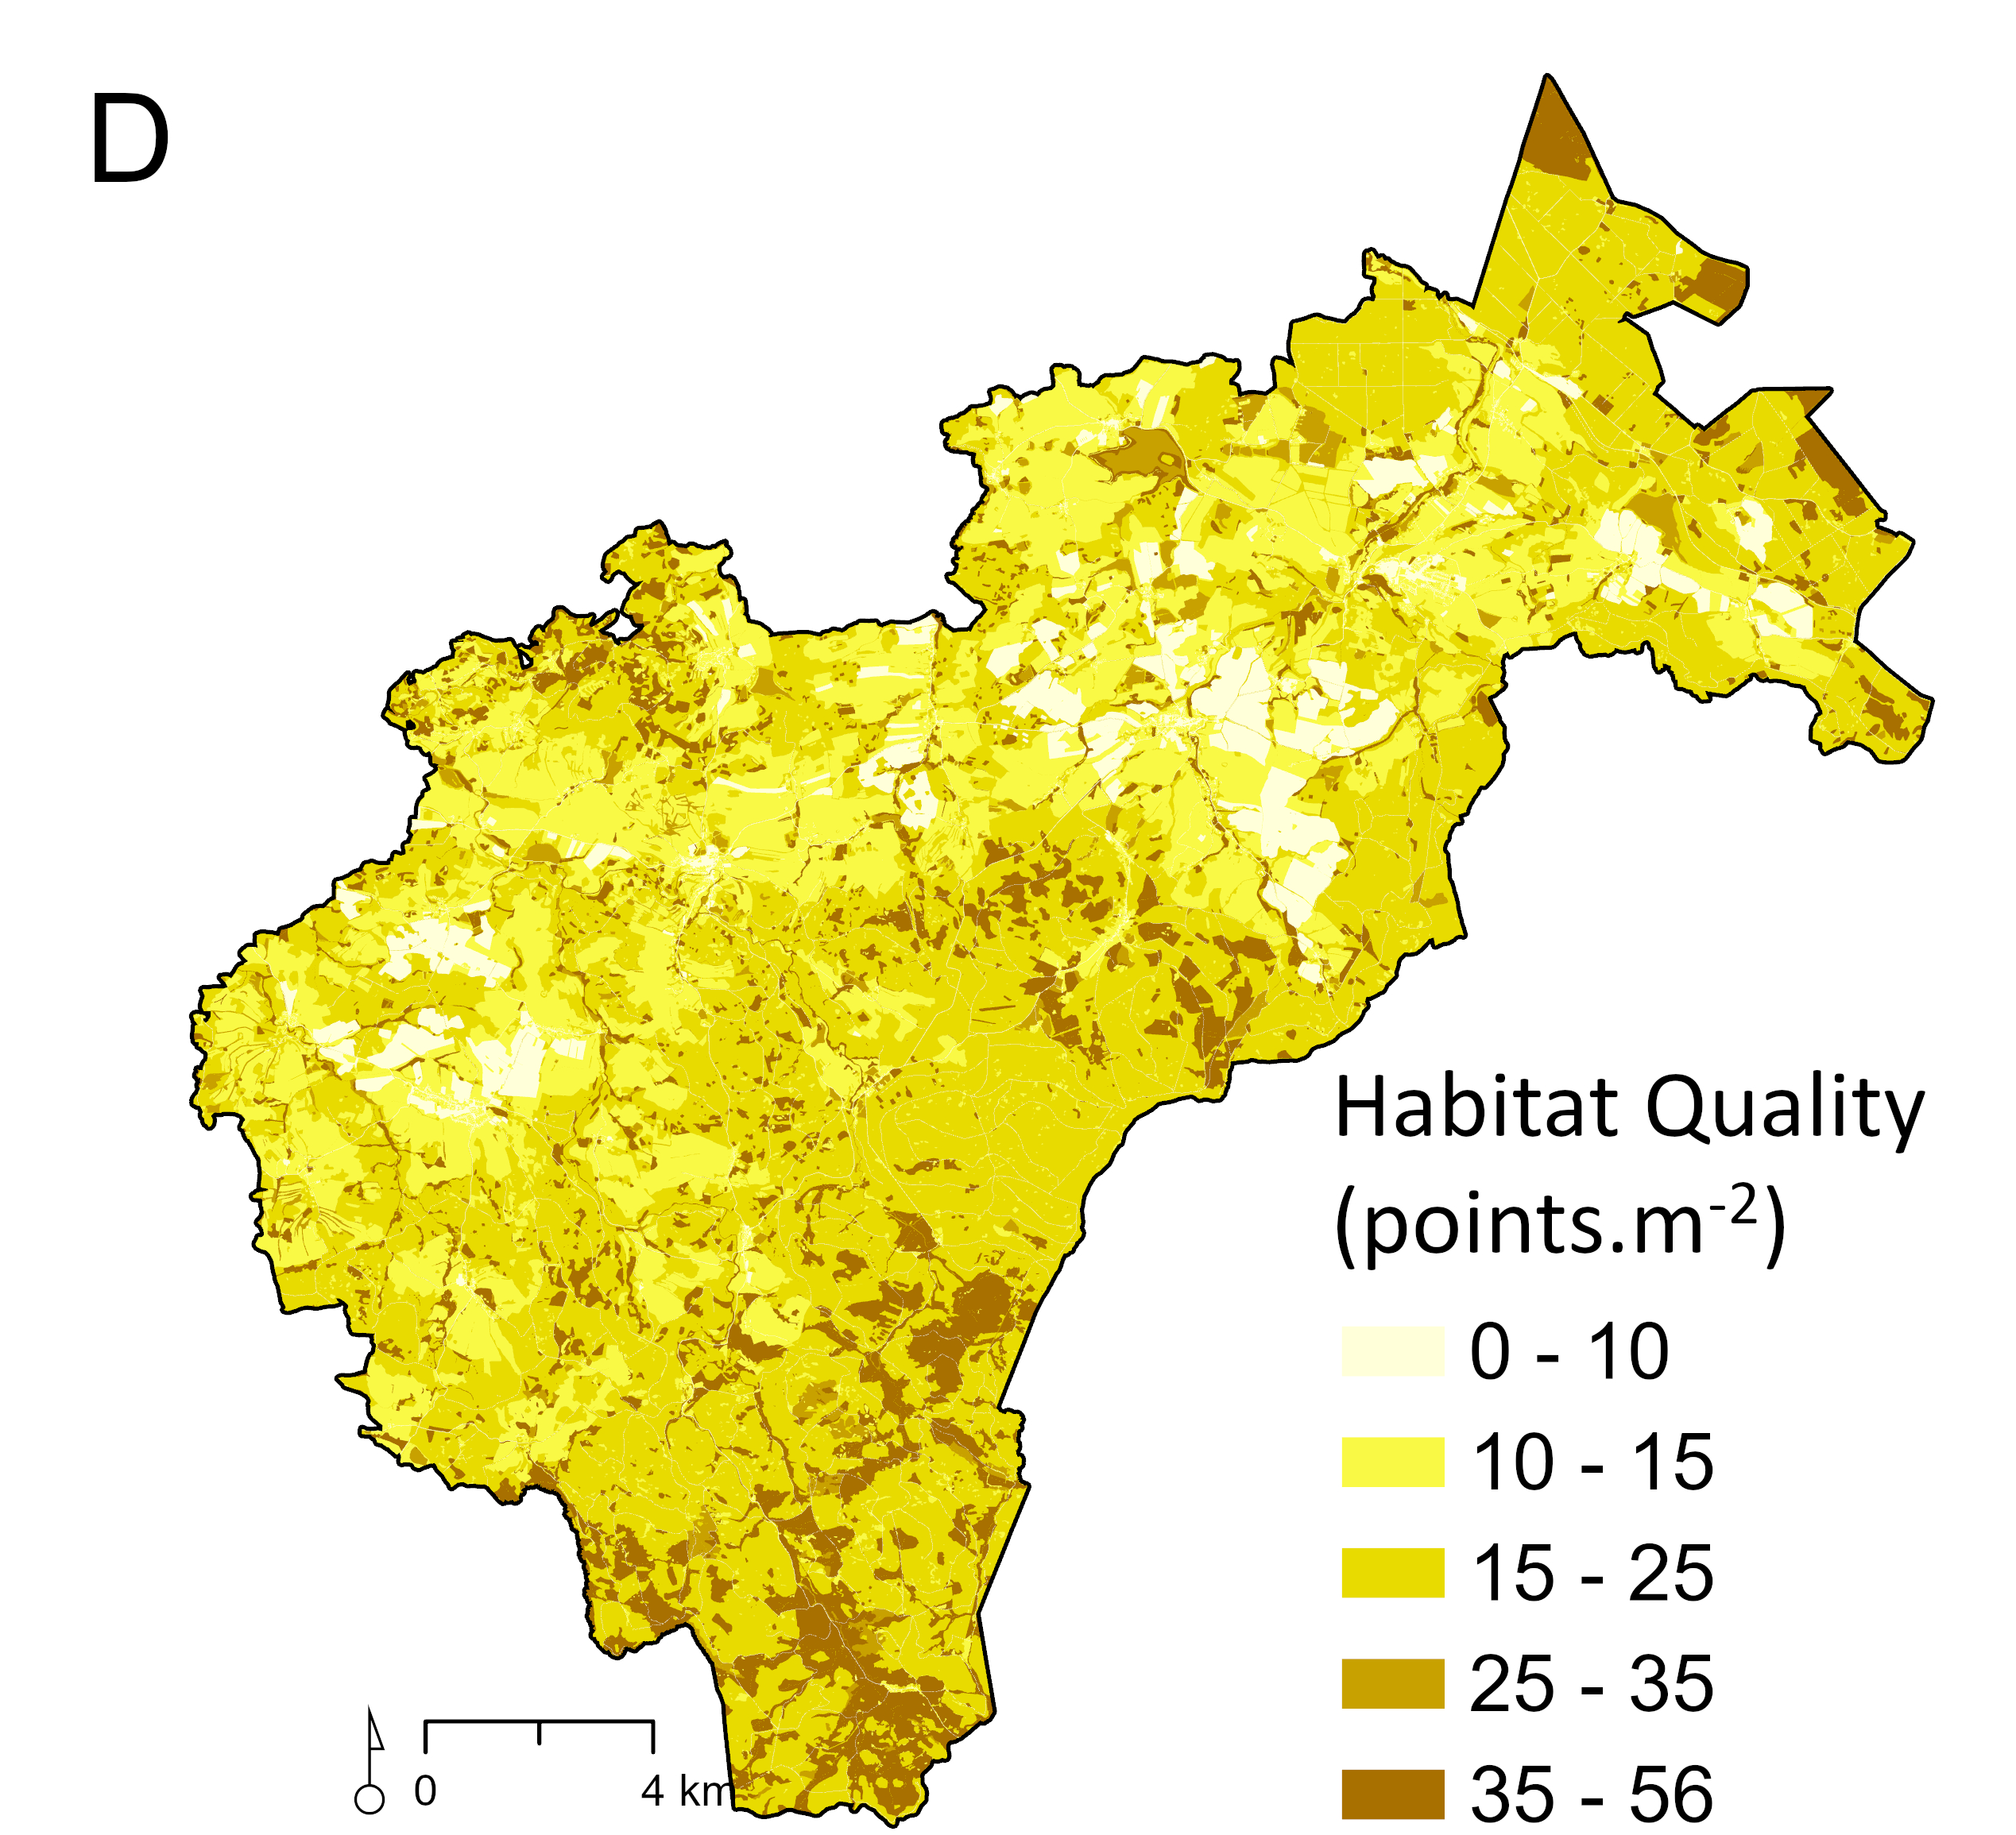
Habitat Quality in the Novohradské hory Mts.

Slide 20
Individual habitat valuation
It corrects the basic point value in the case when the habitat does not correspond with the conditions, described for given type in Catalogue of habitats (Chytrý et al. 2001). The correction is made by means of the coefficients based on following criteria Seják et al. 2018).:

Slide 21
Results
The analysis of the total MSA TOT index showed that the Novohradské hory study area reaches an area-weighted mean value of 0.726, indicating a relatively well-preserved, although not uniformly intact, state of natural habitats. Most of the territory falls within the 0.5–0.75 (48.1%) and 0.75–0.9 (46.7%) classes, with higher values in the south and west and lower values in the agriculturally influenced north and east.
Among the partial CZ-GLOBIO3 indicators, MSA_LU showed the lowest values, confirming that land use is the main factor reducing biodiversity integrity in the study area. By contrast, MSA_F indicates a much more favourable picture of the landscape structure.
Habitat quality assessed using the Habitat Valuation Method (HVM) according to Seják et al. (2018) yielded an area-weighted mean of HB = 20.1 points. The study area is dominated by slightly degraded habitats (76.6%), whereas natural and near-natural habitats together cover 15.1% of the territory, concentrated mainly in the southern and south-eastern parts.

Slide 22
Specific solutions – regulations and recommendations
  Restriction of entry of cars and parking spaces - strengthening of public transport (shuttle-bus), emergency parking lots
  Visitor/traffic restrictions (cars and motorbikes, somewhere also bikes) should be extended in the most threatened sites with the most valuable and endangered natural habitats
  Improving existed marked routes/bike trails
  Establishment of more natural educational trails, especially including cultural monuments in naturally less valuable areas
  Maintaining traditional management of near-natural cultural meadows
  Using these measures, concentrate the majority of visitors to certain areas and on certain routes, so that the more remote parts of the Novohradské hory Mts. will remain a quiet area
Created using ChatGPT and DALL·E, OpenAI, 2024
Notes:
Development of sustainable tourism or ecotourism

Slide 23
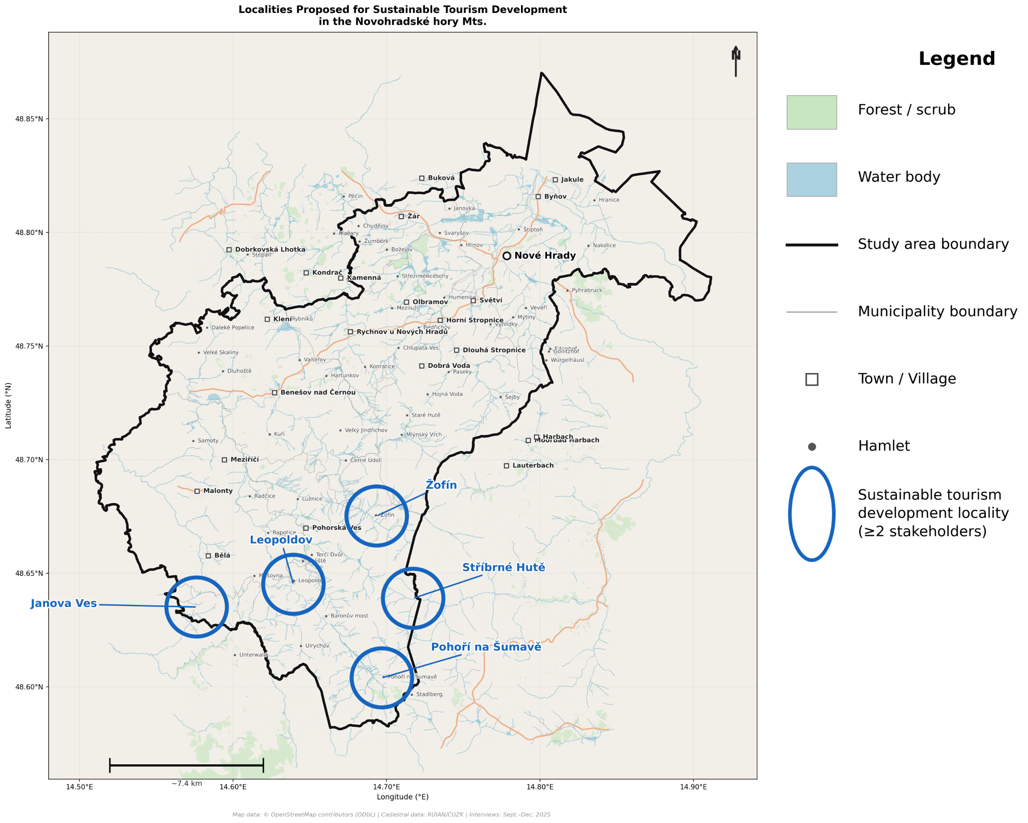
Sites for Sustainable Tourism Development in Novohradské hory Mts.
Tourism development locality – Sites identified through expert interviews (September–December 2025) that were mentioned by at least two respondents as areas with potential for the development of sustainable forms of tourism.
.

Slide 24
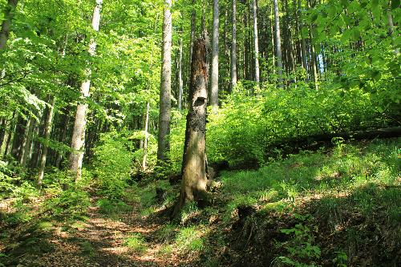
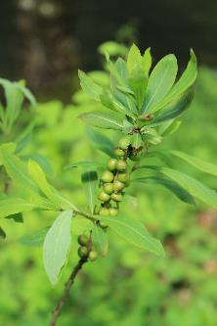
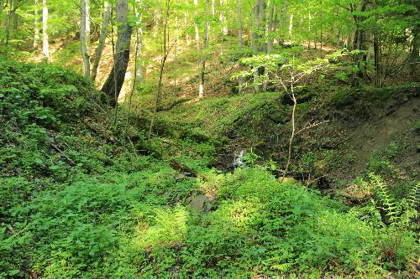
Conclusions - Links between tourism and biodiversity
Further detailed assessment of the state of biodiversity and present number of visitors is needed for the optimizing of tourism and landscape management in the Novohradské hory Mts.
The combination of CZ-GLOBIO3 model, land use change analysis based on CORINE data, and Habitat Valuation Method provide valuable data on the status and threats to biodiversity of natural habitats, which could be used to determination of maximum carrying capacity and specification of management plan of this area.
The maximum carrying recreational capacity has not been overcharged in the area.
Notes:
Model CZ GLOBIO3 showed the areas with the biggest risk of biodiversity loss and degradation of valuable natural habitats caused by land use intensification, infrastructure development and fragmentation impact

Slide 25
Links between restrictions, benefits and compensations in any protected areas
In any protected area, the care must be taken to balance between restrictions and benefits for local residents and businesses in the protected area.
If the economic benefits are not sufficient compared to the lost profit due to restrictions and limitations, the difference must be made up by some financial compensation.

Slide 26


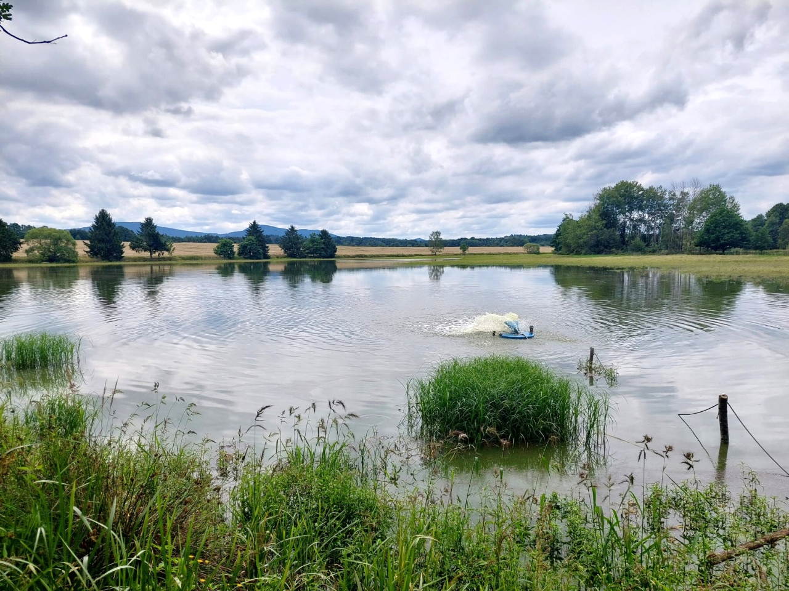

Thank you for your attention
Jan Purkyt – purkyt.j@czechglobe.cz
This presentation is based upon work from COST Action MARGISTAR: A European
forum for revitalisation of marginalised mountain
areas, CA21125, supported by COST (European Cooperation in Science and Technology) and
Inter-COST MŠMT LUC23169 „Vědecky podložená podkladová data pro revitalizaci marginalizovaných horských oblastí v ČR“.
www.cost.eu

