Slide 2
Climate development in the Beskydy Mountains
Pavel Lipina, Veronika Šustková
Křtiny, May 12, 2026

Slide 3
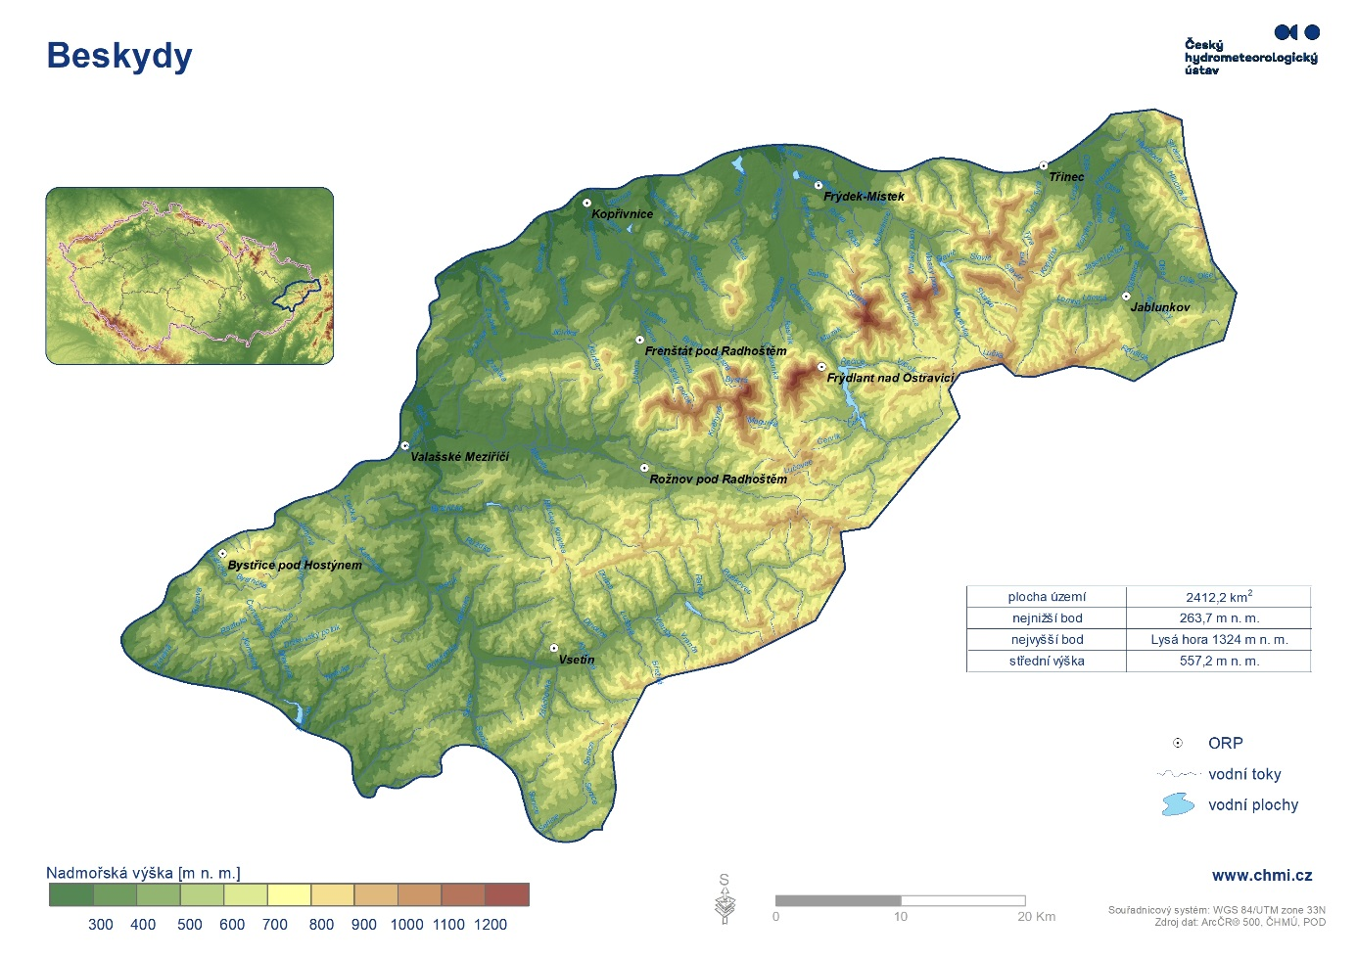
Map of the Beskydy region

Slide 4
Materials and methods
Long-term meteorological data series from the CLIDATA climatological database of the Czech Hydrometeorological Institute were used to calculate the areal characteristics.
The analysis included data from 24 standard stations, 8 snow gauge stations, 40 supplementary stations, and approximately 105 rain gauge stations.
Data from neighboring regions in the Czech Republic, Poland, and Slovakia were also utilized.
Monthly and annual characteristics of air temperature, total precipitation, and new snowfall were analyzed for the period 1874–2025 (approximately 130 years for snow).
Spatial characteristics were derived using interpolation methods that account for the influence of orography, particularly the local linear regression (LLR) method and ClidataDEM.

Slide 5
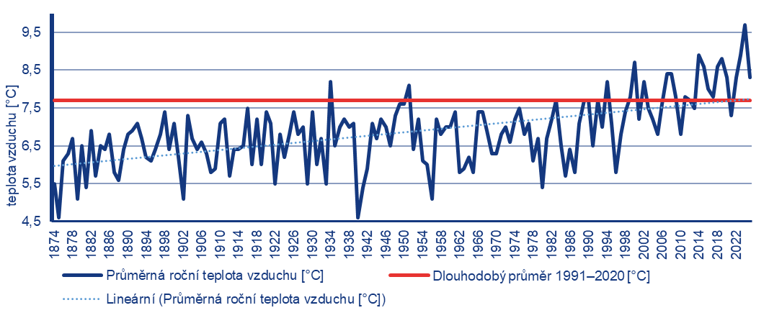
Average annual air temperature calculated for a defined area of the Beskydy Mountains, compared with the 1991–2020 normal period and the linear trend
2023 | 8,9
2024 | 9,7
2025 | 8,3
max | 9,7 | 2024
min | 4,6 | 1875, 1940
1934 | 8,2
1951 | 8,1
2000 | 8,7

Slide 6
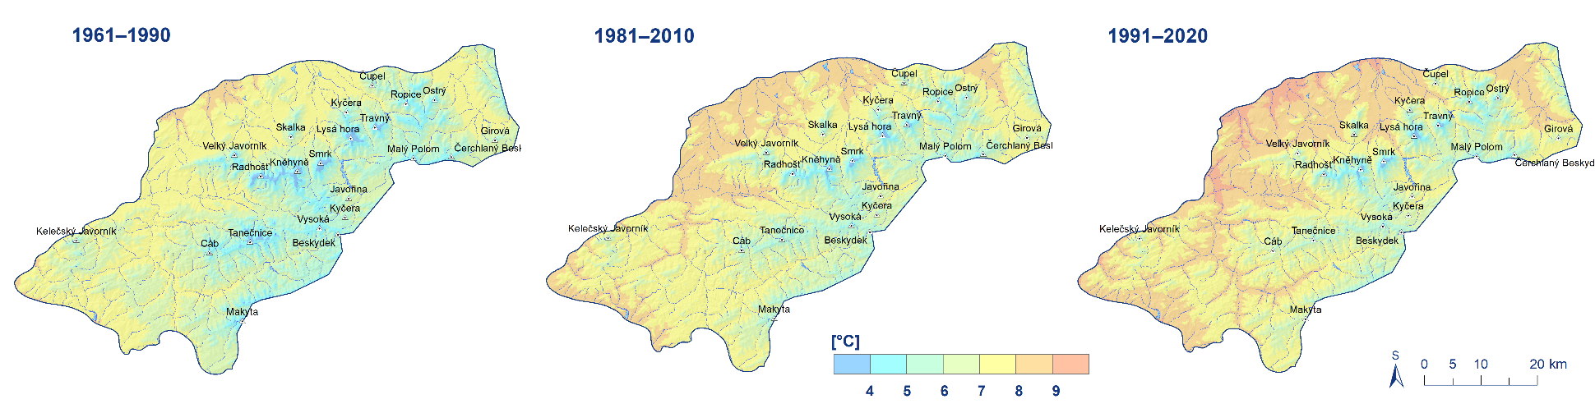
Long-term averages of air temperature in the Beskydy Mountains for the periods 1961–1990, 1981–2010, and 1991–2020
The average annual air temperature in the Beskydy Mountains over the past 152 years has shown an upward trend of 0.118 °C per decade.
Over the entire study period, it has increased by 1.8 °C.
The 1901–1930 temperature norm had an annual air temperature of 6.5 °C,
the 1931–1960 and 1961–1990 norms were both 6.7 °C,
and the 1991–2020 norm was 7.7 °C.
For the years 2021–2025, the average annual temperature is 8.5 °C

Slide 7
Climate development in the Beskydy region up to the year 2100
We also outlined the potential climate development in the Beskydy region up to the year 2100 based on the regional ALADIN-CLIMATE/CZ model (ALARO configuration, 2.3 km resolution, Brožková et al. 2019) as part of the PERUN project (PERUN 2022). Two emission scenarios were evaluated: SSP2-4.5 and SSP5-8.5 (IPCC, 2021).
Figure on the next page below shows that, according to both the SSP2-4.5 and SSP5-8.5 socioeconomic scenarios, the trend of rising air temperatures in the Beskydy Mountains will continue.
According to model simulations based on the medium emissions scenario SSP2-4.5, average air temperatures in the Beskydy Mountains are expected to rise by 2.2 °C by the end of the 21st century compared to the current climate (1991–2020).
Under the pessimistic scenario SSP5-8.5, the increase is as high as 4.7 °C.

Slide 8
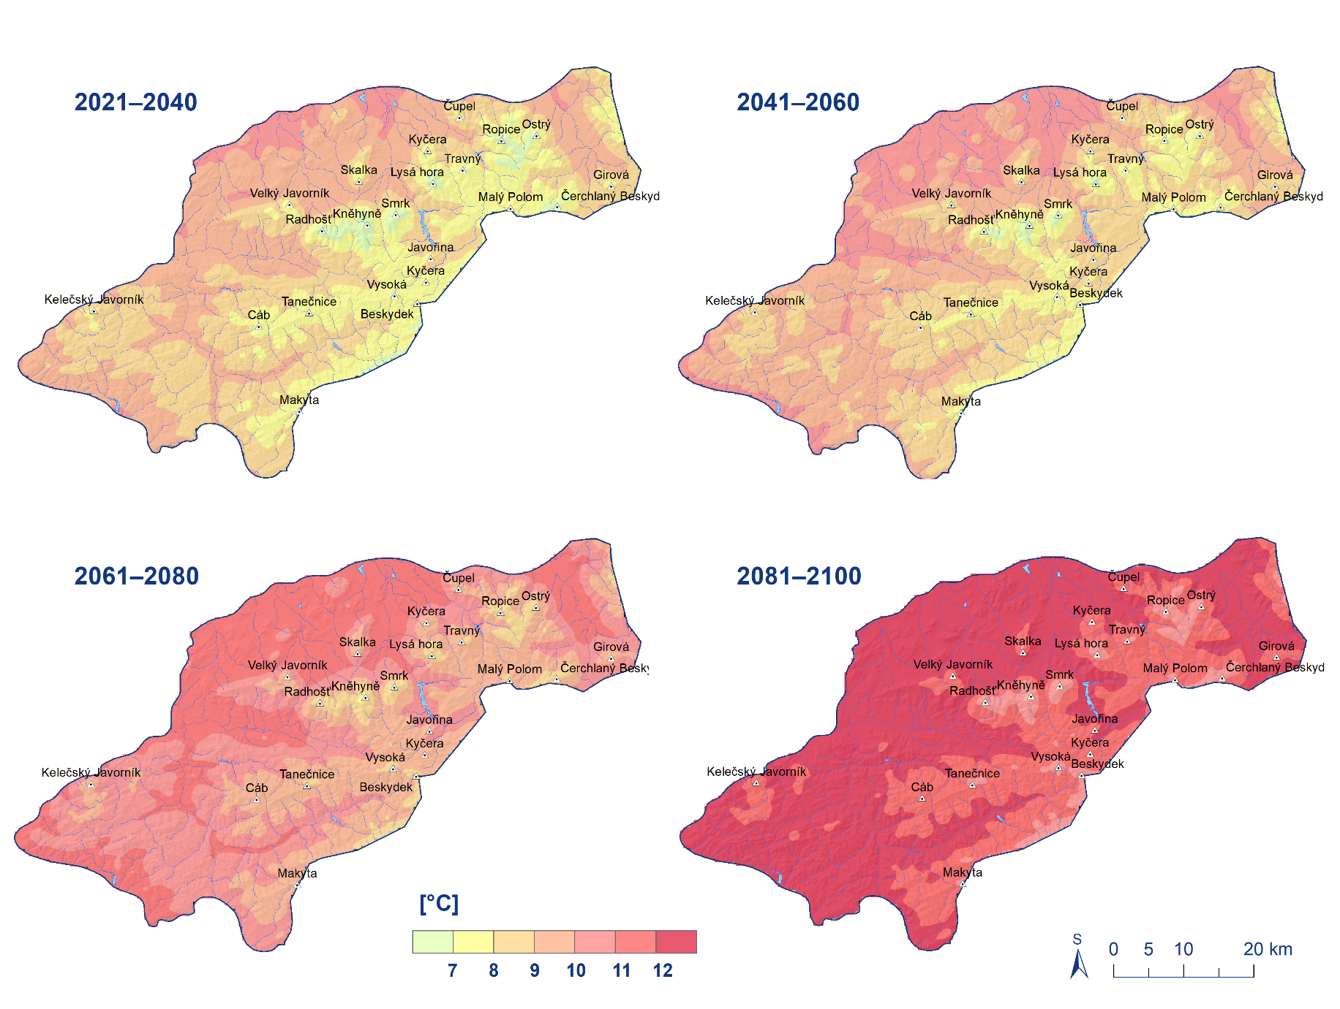
Average annual air temperature in the Beskydy Mountains for the SSP5-8.5 scenario and individual 20-year periods.

Slide 9
Annual precipitation [mm] in the Beskydy

Slide 10
Annual total of new snow [cm] in Beskydy

Slide 11
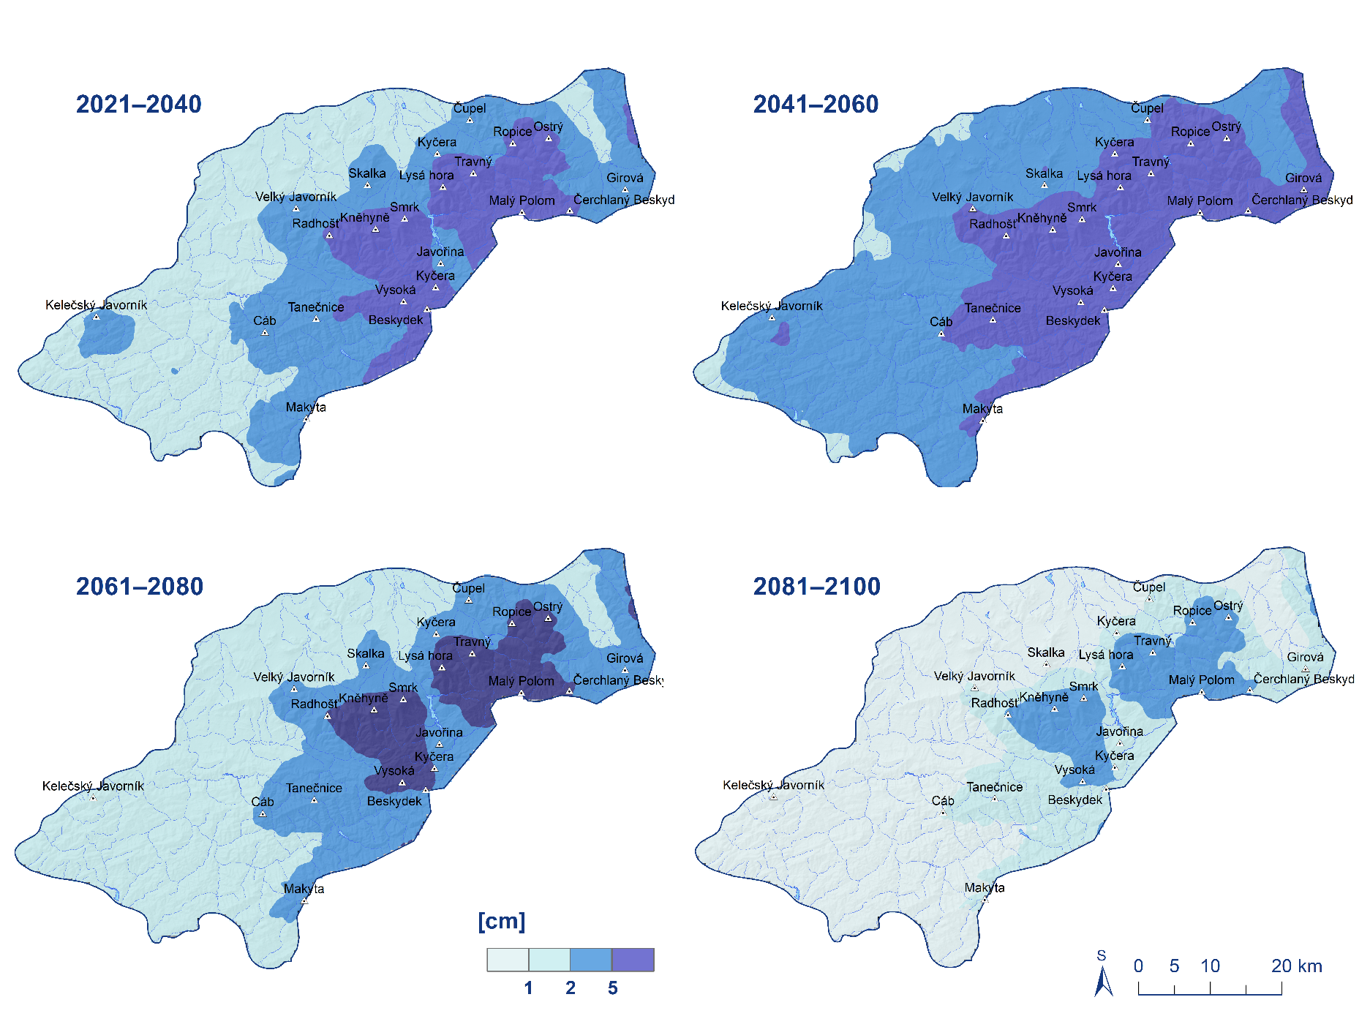
Average annual snow depth (cm) in the Beskydy Mountains for the SSP5-8.5 scenario and individual 20-year periods

Slide 12
Regional characteristics for elevation zones in the Beskydy Mountains according to the SSP5-8.5 scenario.

Slide 13
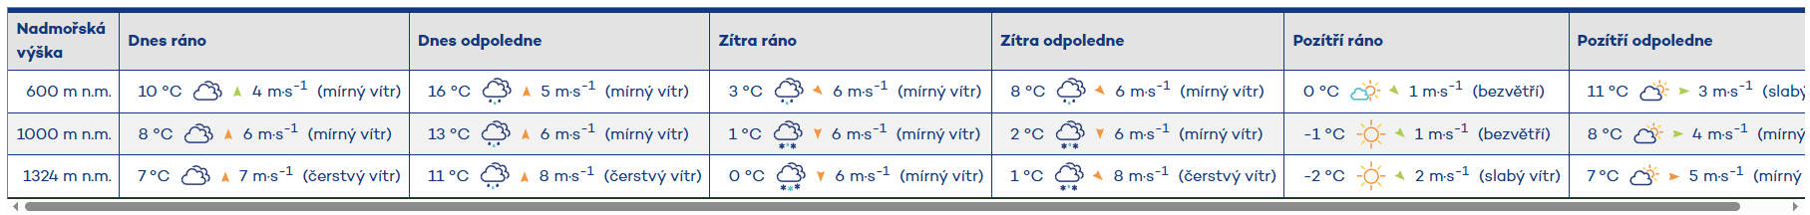
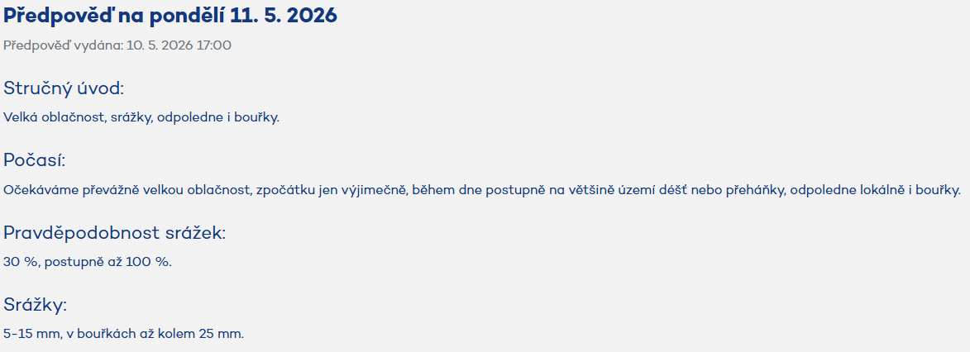
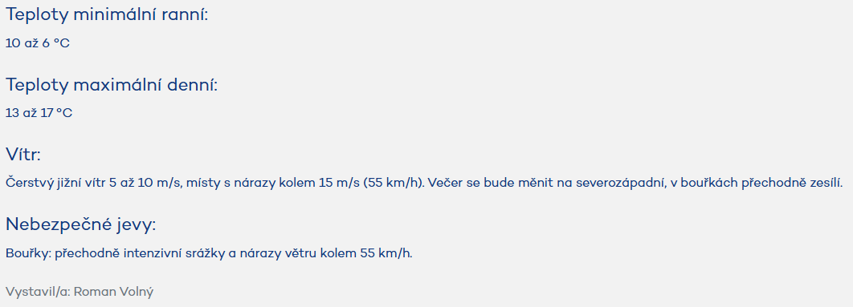
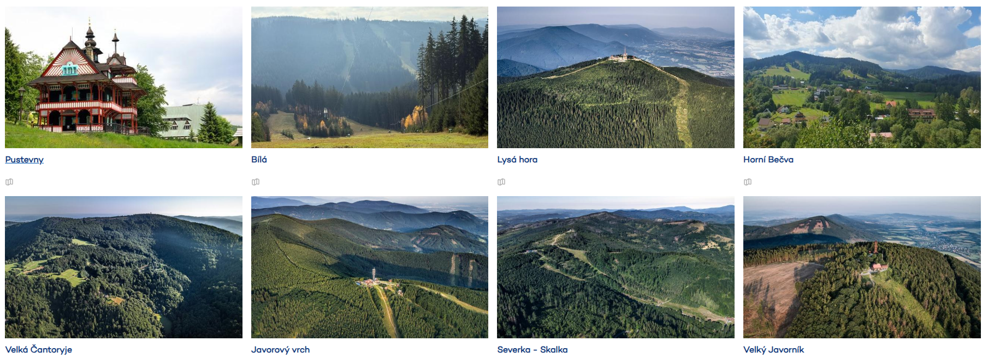
Weather Forecast for the Beskydy Mountains (CHMI web)

Slide 14
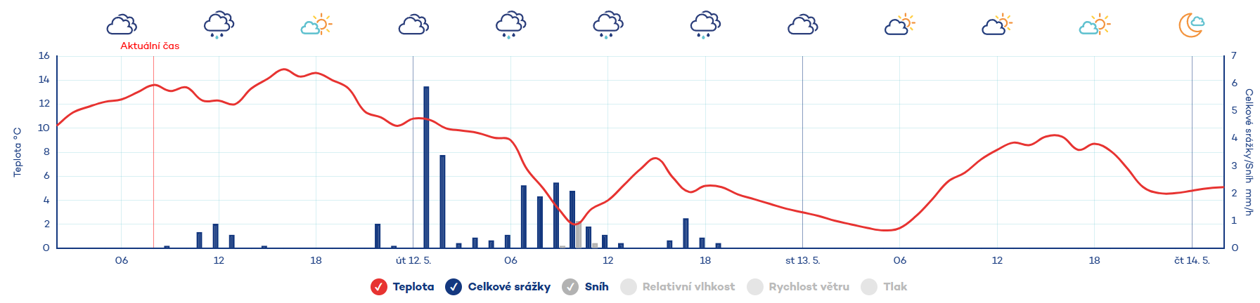
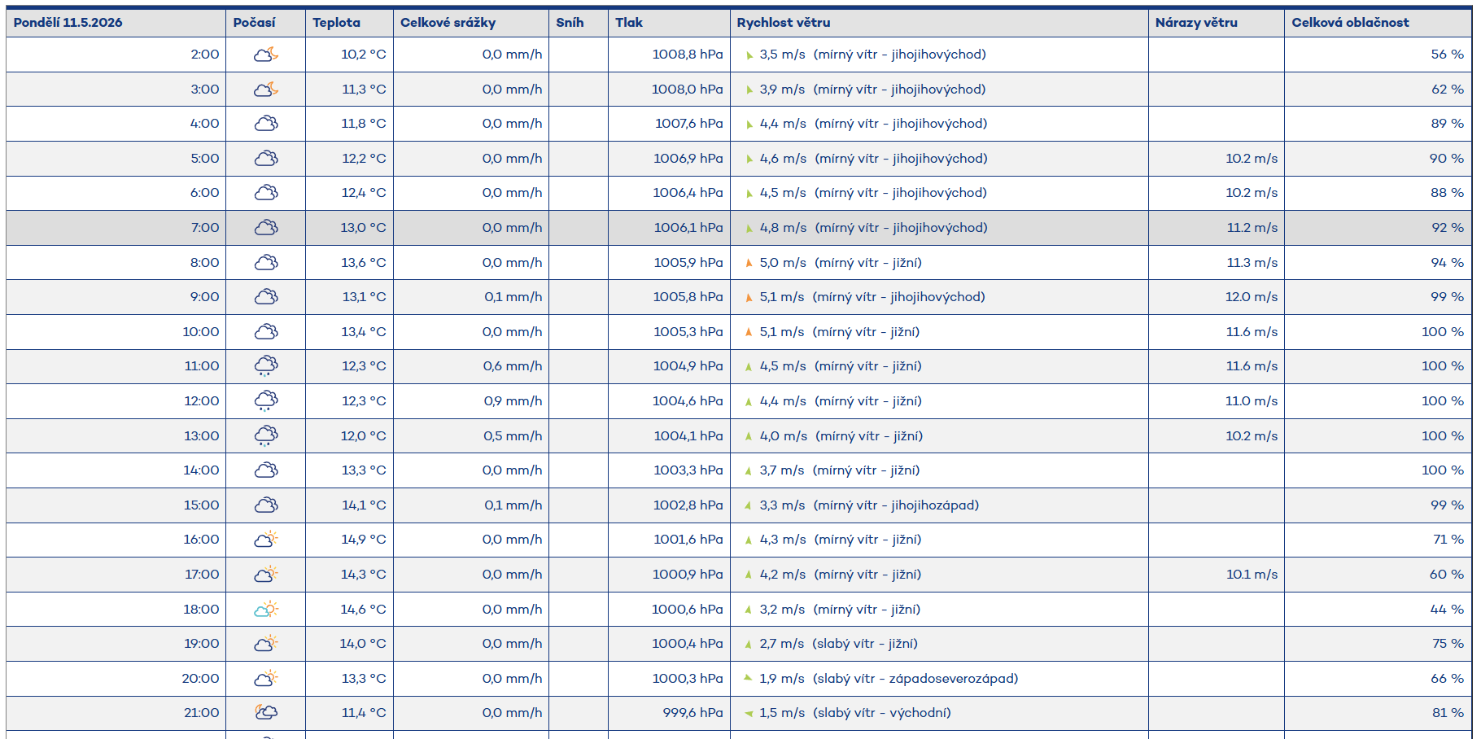

Slide 15
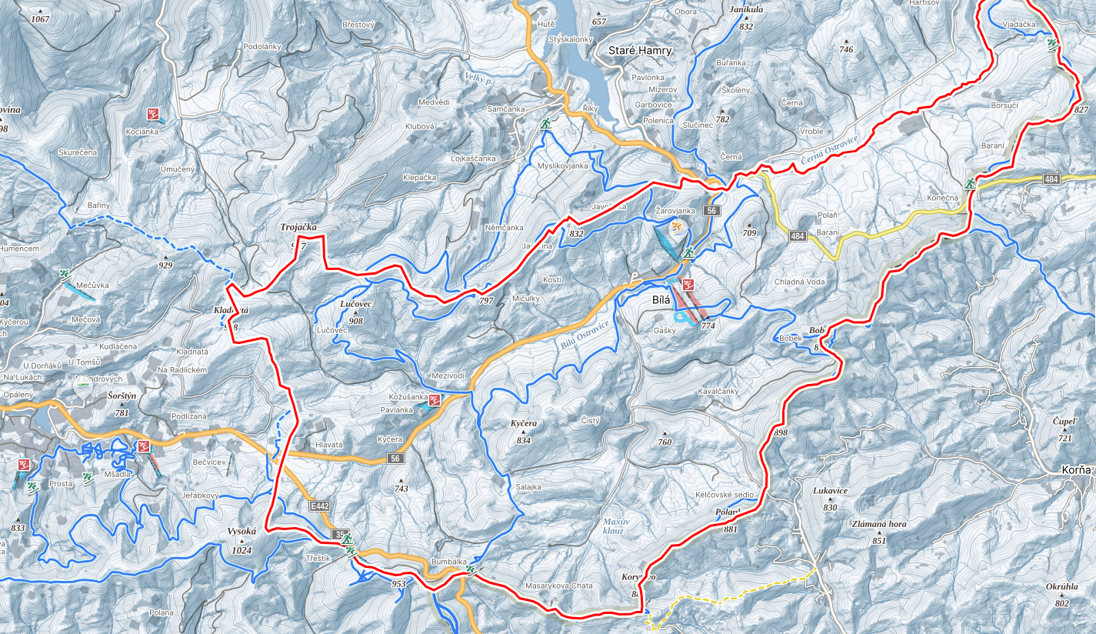
Winter map in Bílá in the Beskydy Mountains

Slide 16
Bílá –Total new snowfall for the winter season [cm]

Slide 17
Bílá – Annual maximum total snow depth (cm)
1944 | 198 |  | 1990 | 26
2005 | 162 |  | 2011 | 25
2006 | 148 |  | 2014 | 16
2012 | 145 |  | 2024 | 18
1936–1960 | 98
1961–1990 | 82
1991–2020 | 75
2021–2025 | 51

Slide 18
Snow conditions (fresh snow and total snow cover) and maximum and minimum air temperatures during the 2025/2026 winter season in Bílá in the Beskydy Mountains

Slide 19
Snow conditions (fresh snow and total snow cover) and maximum and minimum air temperatures during the 2025/2026 winter season in Bílá in the Beskydy Mountains
Conditions for downhill skiing were excellent at least until mid-March. The actual 2025/2026 season at the Bílá Ski Resort began around November 29, 2025, with full operations starting in mid-December 2025 and the season ending on March 23, 2026. The resort was not open all day every day (limited operations at the beginning and end of the season). The full season (most slopes) lasted from December 20, 2025, to March 15, 2026, offering approximately 85–90 days of quality skiing.
This winter also offered ideal conditions for cross-country skiing. There are four cross-country trails in and around Bílá. The approximately 15 cm of natural snow required for good trail conditions was recorded from December 28, 2025, through early February 2026.

Slide 20
Conclusions
The average annual air temperature in the Beskydy Mountains over the past 150 years has shown an upward trend of 0.118 °C per decade.
While it was 6.5 °C during the period 1901–1930, it has reached 8.5 °C in the last five years (2021–2025).
Annual precipitation totals show a slight downward trend of 5.5 mm per 10 years. Between individual normal periods, annual totals generally range from 986 to 1,086 mm.
Year-to-year variability is considerable, with no statistically significant trend; however, a shift in the distribution of precipitation throughout the year toward more intense episodes is evident.
The total amount of new snow in the Beskydy Mountains has shown a decreasing trend over the past 130 years (1896–2025) of 1.9 cm per 10 years; the seasonal snow total for 1991–2020 was 197 cm, and for 2021–2025, only 140 cm.
An analysis of future climate trends in the Beskydy Mountains based on outputs from the ALADIN-CLIMATE/CZ regional climate model confirms that projections of future climate trends correspond to trends already observed in long-term meteorological data series, particularly the rise in air temperature and the decline in snow cover.

Slide 21
Acknowledgement
This contribution was created as part of the project QL24020351 “Update of the Forest Typological Classification System, including the determination of the expected development of forest vegetation zones with an evaluation of the influence of meso- and microclimate in view of ongoing climate change and its prediction,” and with the support for the development of the research organization no. MZE-RO0123.
This contribution was supported by the state support from the Technology Agency of the Czech Republic (Project SS02030040 PERUN - Prediction, Evaluation and Research for Under-standing National sensitivity and impacts of drought and climate change for Czechia).
Contact:
Pavel Lipina
E-mail: pavel.lipina@chmi.cz

