Slide 1
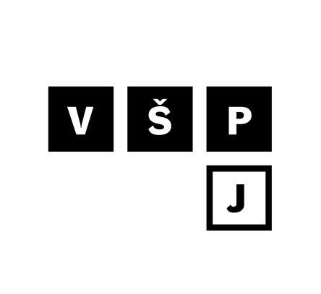
MINING HERITAGE IN THE CULTURAL LANDSCAPE OF THE VYSOČINA REGION: RESIDENTS´AWARENESS AND PERCEPTION OF TOURISM VALUE
BLANKA ŠIMÁNKOVÁ HORNOVÁ, TOMÁŠ ČIHÁK, STANISLAVA PACHROVÁ
COLLEGE OF POLYTECHNICS JIHLAVA

Slide 2
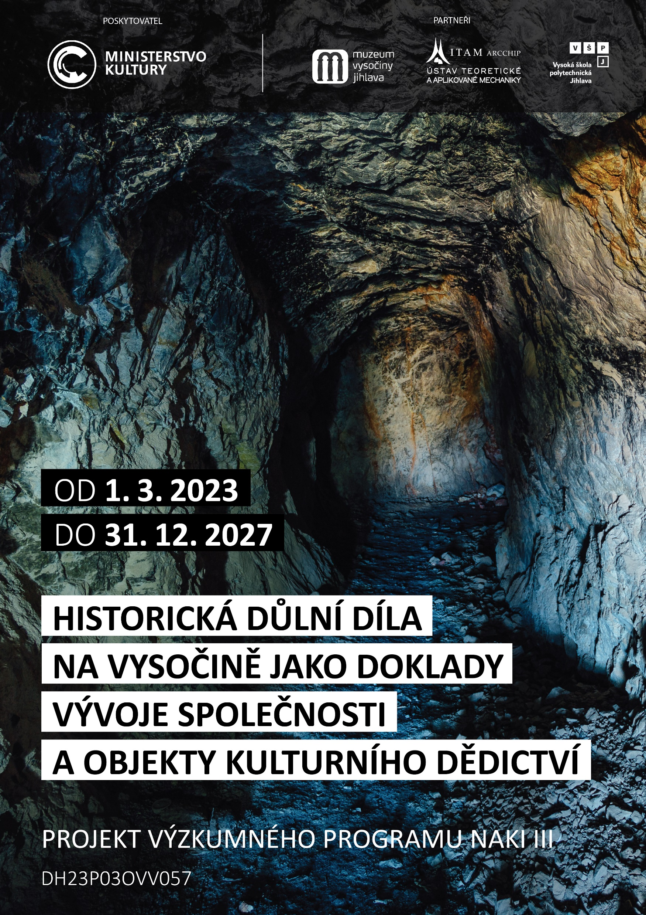
WHY ARE WE HERE?
Project Historical Mining Sites in the Vysočina Region as Evidence of Societal Development and Objects of Cultural Heritage” (project no. DH23P03OVV057
NAKI III programme, Ministry of Culture of the Czech Republic
Project partners:
The Vysočina Museum in Jihlava
Institute of Theoretical and Applied Mechanics, Czech Academy of Sciences
College of Polytechnics Jihlava
Implementation period: 2023-2027

Slide 3
PROJECT OBJECTIVE, KEY PLANNED OUTCOMES
The Project Objective:
develop tools and define procedures that will enable us to understand historical mining works and the extraction of raw materials in general not only as a fundamental element of societal development, but also as significant drivers of—and evidence of—landscape evolution, as well as key components of cultural identity, national characteristics, and their evolution over time. At the same time, the project addresses the issues of understanding, protecting, interpreting, and utilizing historical mining works as an important form of cultural heritage. The project offers new perspectives on historical mining works as elements of cultural identity that are currently under serious threat, while also providing tools for their effective protection, utilization, and interpretation.
Key Planned Outcomes (College of Polytechnics Jihlava)
Methodology for the Evaluation and Selection of Historic Mining Sites as Cultural Heritage Interpretation Sites
Field Data Collection - Research on Citizens' Cultural Identity

Slide 4

SIGHTSEEING TOURS OF HISTORIC MINES
In the Czech Republic
Vysočina Region (Jihlava, Přibyslav, Stříbrné Hory, Jemnice - Pekelská štola, Růženina štola, Štoly Jan Nepomucký a Terezie)
Montanregion Krušné Mountains/Erzgebirge (Důl Mauritius, štola Johannes, Annaberg- Buchholz)
Kašperské Mountains (štola Kristýna), Stříbro (Královská dědičná štola Prokop), Příbram (Hornické muzeum)
Kutná Hora, Jílové u Prahy – planned
Abroad
Bavaria and Austria (Bad Reichenhall, Berchtesgaden, Hallstatt)
Poland (Wieliczka, Bochnia, Tarnowskie Góry)
Slovakia (Banská Štiavnica, Hodruša-Hámre, Špania Dolina) – planned

Slide 5
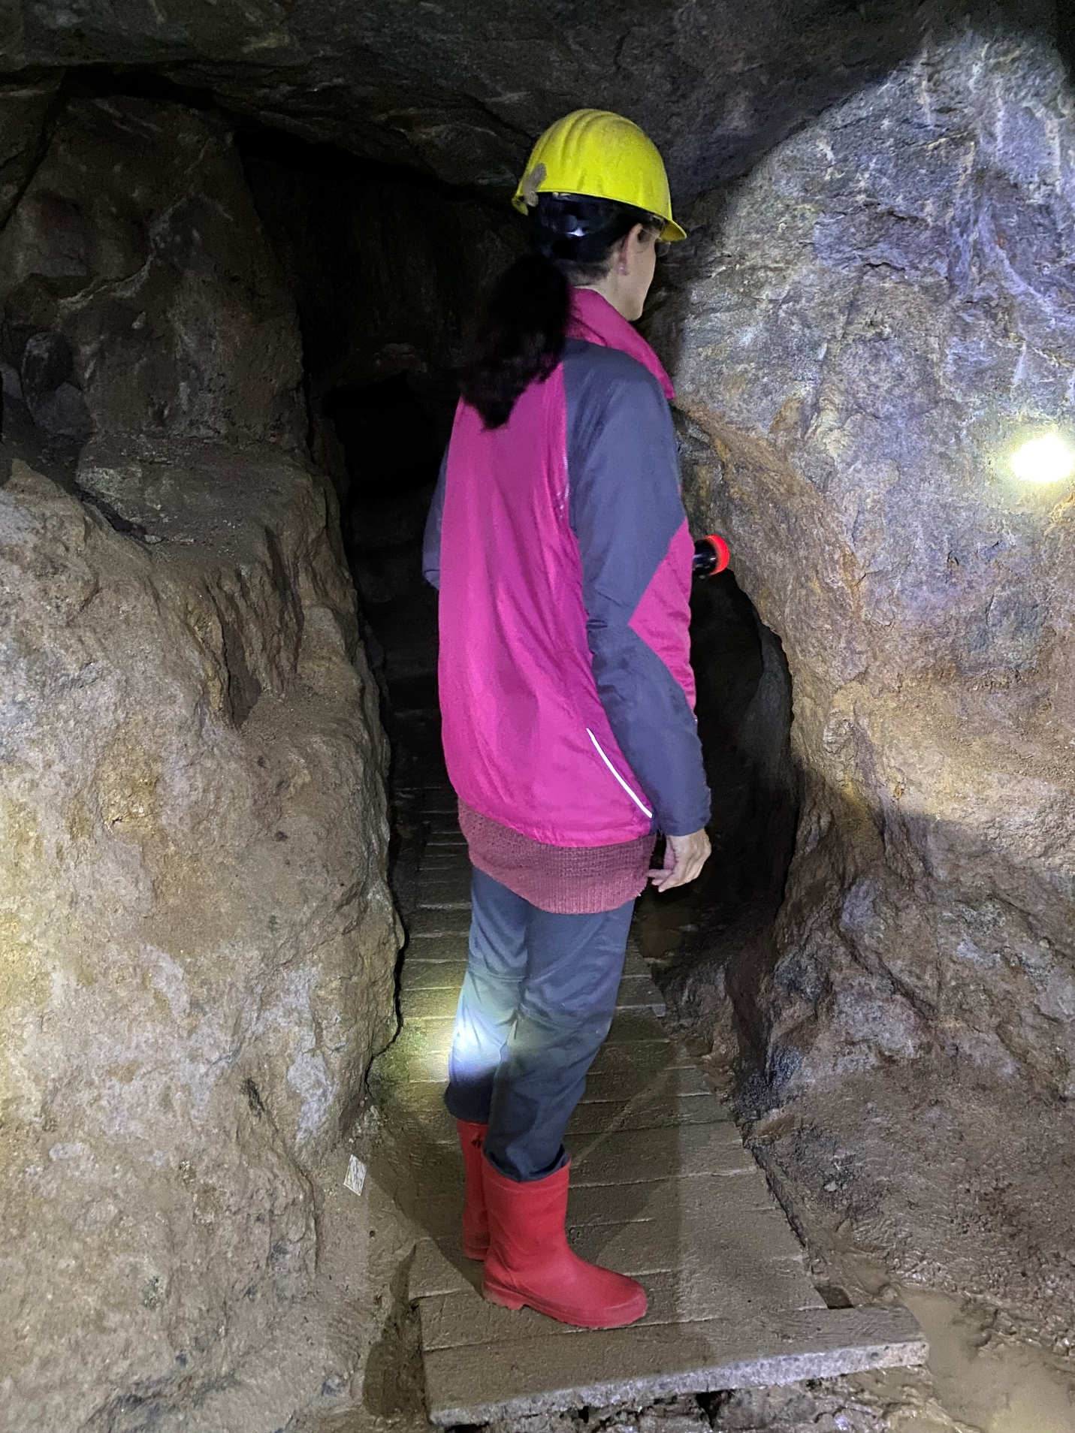
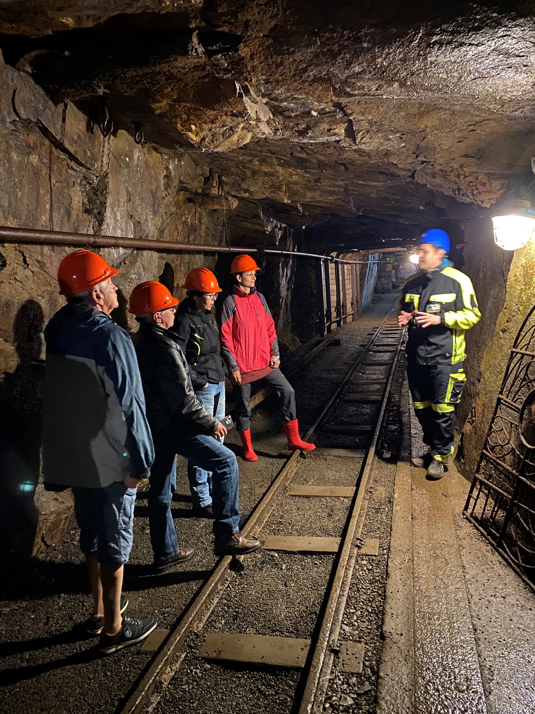
SIGHTSEEING TOURS – FIELD TRIPS

Slide 6
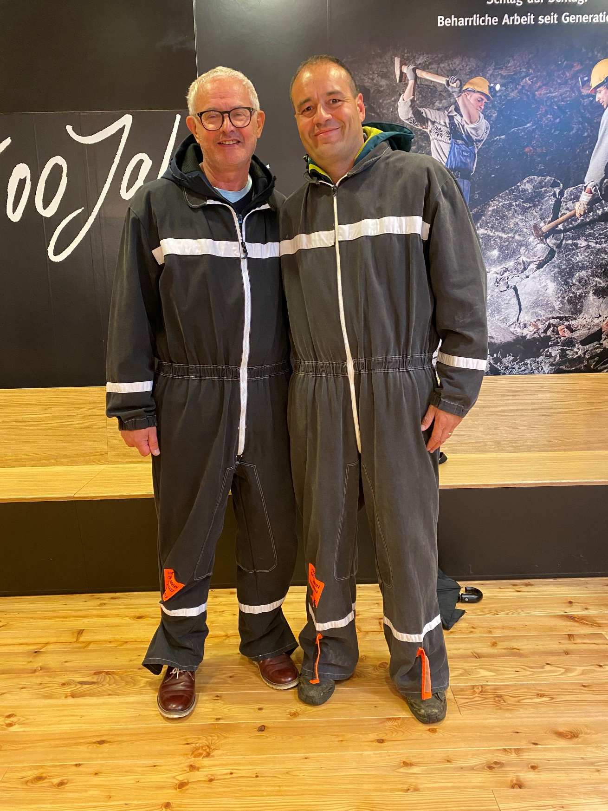
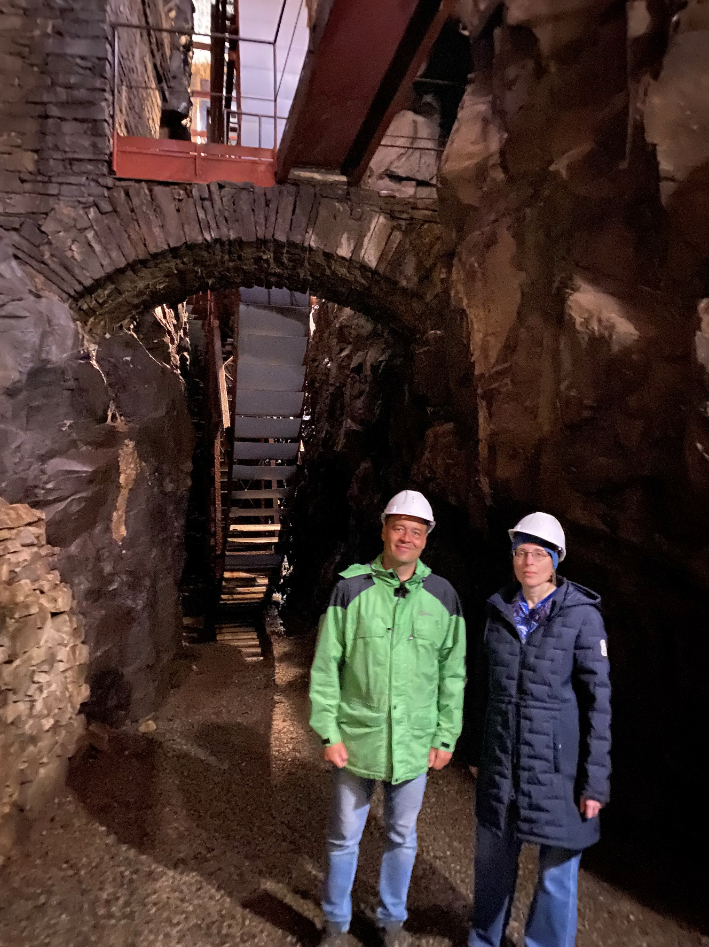
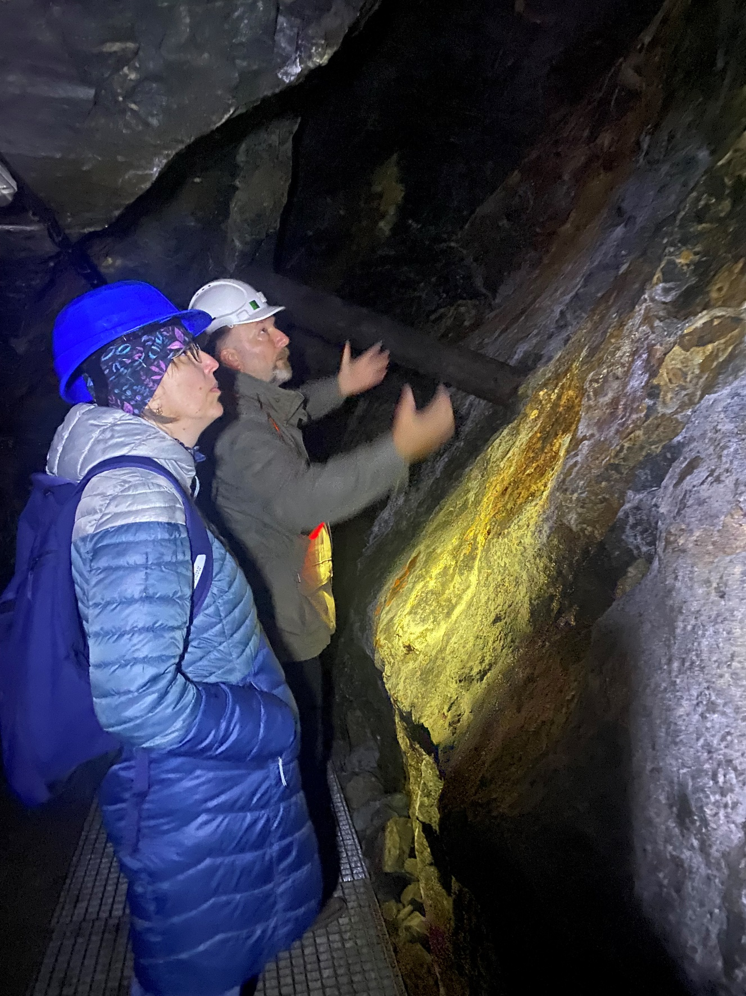
SIGHTSEEING TOURS – FIELD TRIPS

Slide 7
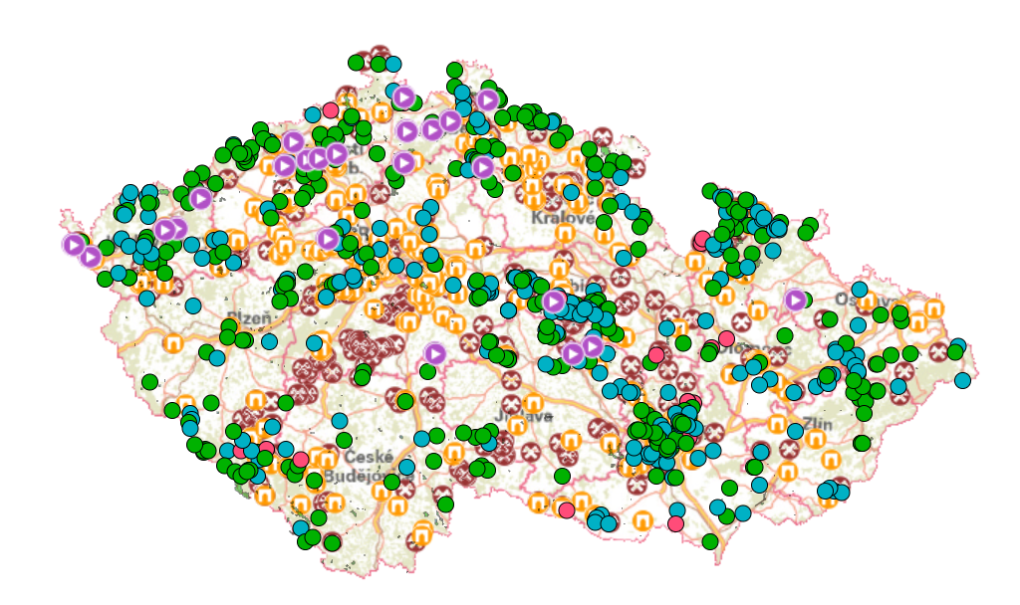
RESEARCH ON CITIZENS´CULTURAL IDENTITY
(Czech Republic Geoportal: Mining Sites, 2026)

Slide 8
RESEARCH ON CITIZENS´CULTURAL IDENTITY (SELECTION OF MUNICIPALITIES)
Municipality | Region | District | Mined ore | Population
Kadov | Vysočina | Žďár nad Sázavou | iron | 153
Sněžné | Vysočina | Žďár nad Sázavou | iron | 718
Fryšava pod Žákovou horou | Vysočina | Žďár nad Sázavou | iron | 321
Jemnice | Vysočina | Třebíč | silver | 3,908
Želetava | Vysočina | Třebíč | gold | 1,438
Humpolec | Vysočina | Pelhřimov | gold | 10,835
Vyskytná | Vysočina | Pelhřimov | silver | 692
Kutná Hora | Středočeský | Kutná Hora | silver | 20,162
Jílové u Prahy | Středočeský | Praha-západ | gold | 5,049
Stříbro | Plzeňský | Tachov | silver | 7,519
Kašperské Hory | Plzeňský | Klatovy | gold | 1,361
Jáchymov | Karlovarský | Karlovy Vary | silver/tin/ uranium | 2,207
Municipality | Region | District | Mined ore | Population
Jihlava | Vysočina | Jihlava | silver | 50,523
Svojkovice | Vysočina | Jihlava | gold | 43
Přibyslav | Vysočina | Havlíčkův Brod | silver | 3,823
Stříbrné Hory | Vysočina | Havlíčkův Brod | silver | 253
Bartoušov | Vysočina | Havlíčkův Brod | silver | 155
Česká Bělá | Vysočina | Havlíčkův Brod | silver | 1,047
Štěpánov nad Svratkou | Vysočina | Žďár nad Sázavou | silver | 694
Koroužné | Vysočina | Žďár nad Sázavou | silver | 253
Kadov | Vysočina | Žďár nad Sázavou | iron | 153
(Czech Statistical Office – Database of Demographic Data for Municipalities in the Czech Republic; 2021 Census of Population, Houses, and Apartments)

Slide 9
RESEARCH ON CITIZENS´CULTURAL IDENTITY (POPULATION STRUCTURE – PROPORTION OF MEN AND WOMEN)
Population structure in municipalities in terms of the proportion of men and women
Municipality | Population | Men | Women | Men in % | Women in %
Jihlava | 50,523 | 24,761 | 25,762 | 49.0 | 51.0
Svojkovice | 43 | 20 | 23 | 46.5 | 53.5
Přibyslav | 3,823 | 1,909 | 1,914 | 49.9 | 50.1
Stříbrné Hory | 253 | 132 | 121 | 52.2 | 47.8
Bartoušov | 155 | 90 | 65 | 58.1 | 41.9
Česká Bělá | 1,047 | 531 | 516 | 50.7 | 49.3
Štěpánov nad Svratkou | 694 | 352 | 342 | 50.7 | 49.3
Koroužné | 253 | 139 | 114 | 54.9 | 45.1
Kadov | 153 | 87 | 66 | 56.9 | 43.1
Sněžné | 718 | 360 | 358 | 50.1 | 49.9
Fryšava pod Žákovou horou | 321 | 164 | 157 | 51.1 | 48.9
Jemnice | 3,908 | 1,908 | 2,000 | 48.8 | 51.2
Želetava | 1,438 | 732 | 706 | 50.9 | 49.1
Humpolec | 10,835 | 5,342 | 5,493 | 49.3 | 50.7
Vyskytná | 692 | 343 | 349 | 49.6 | 50.4
Kutná Hora | 20,162 | 9,914 | 10,248 | 49.2 | 50.8
Jílové u Prahy | 5,049 | 2,497 | 2,552 | 49.5 | 50.5
Stříbro | 7,519 | 3,727 | 3,792 | 49.6 | 50.4
Kašperské Hory | 1,361 | 676 | 685 | 49.7 | 50.3
Jáchymov | 2,207 | 1,045 | 1,162 | 47.3 | 52.7
(Czech Statistical Office – Database of Demographic Data for Municipalities in the Czech Republic; 2021 Census of Population, Houses, and Apartments)

Slide 10
RESEARCH ON CITIZENS´ CULTURAL IDENTITY (AGE STRUCTURE)
Age Structure of the Population in Municipalities |  |  |  |  | Population at the age 15-65+
Municipality | Population | Age 0-14 | Age 15-64 | Age 65+ | In total | Age 15-64 in % | Age 65+ in %
Jihlava | 50,523 | 8,046 | 31,943 | 10,534 | 42,477 | 75.2 | 24.8
Svojkovice | 43 | 1 | 27 | 15 | 42 | 64.3 | 35.7
Přibyslav | 3,823 | 692 | 2,335 | 796 | 3,131 | 74.6 | 25.4
Stříbrné Hory | 253 | 43 | 170 | 40 | 210 | 81.0 | 19.0
Bartoušov | 155 | 22 | 101 | 32 | 133 | 75.9 | 24.1
Česká Bělá | 1,047 | 209 | 659 | 179 | 838 | 78.6 | 21.4
Štěpánov nad Svratkou | 694 | 122 | 415 | 157 | 572 | 72.6 | 27.4
Koroužné | 253 | 49 | 138 | 66 | 204 | 67.6 | 32.4
Kadov | 153 | 25 | 99 | 29 | 128 | 77.3 | 22.7
Sněžné | 718 | 119 | 436 | 163 | 599 | 72.8 | 27.2
Fryšava pod Žákovou horou | 321 | 38 | 195 | 88 | 283 | 68.9 | 31.1
Jemnice | 3,908 | 586 | 2,480 | 842 | 3,322 | 74.7 | 25.3
Želetava | 1,438 | 226 | 918 | 294 | 1,212 | 75.7 | 24.3
Humpolec | 10,835 | 1,643 | 6,714 | 2,478 | 9,192 | 73.0 | 27.0
Vyskytná | 692 | 115 | 431 | 146 | 577 | 74.7 | 25.3
Kutná Hora | 20,162 | 3,051 | 12,787 | 4,324 | 17,111 | 74.7 | 25.3
Jílové u Prahy | 5,049 | 1,030 | 3,128 | 891 | 4,019 | 77.8 | 22.2
Stříbro | 7,519 | 1,104 | 4,960 | 1,455 | 6,415 | 77.3 | 22.7
Kašperské Hory | 1,361 | 209 | 785 | 367 | 1,152 | 68.1 | 31.9
Jáchymov | 2,207 | 275 | 1,453 | 479 | 1,932 | 75.2 | 24.8
(Czech Statistical Office – Database of Demographic Data for Municipalities in the Czech Republic; 2021 Census of Population, Houses, and Apartments)

Slide 11
RESEARCH ON CITIZENS´ CULTURAL IDENTITY (EDUCATION STRUCTURE)
Educational Structure of the Population in Municipalities
Municipality | Population at the age 15+ | Highest level of education achieved
 | 15+ | without education | basic | secondary | advanced vocational | higher education | not determined
Jihlava | 42,477 | 243 | 4,925 | 27,124 | 647 | 7,099 | 2,439
Svojkovice | 42 | 0 | 11 | 27 | 0 | 3 | 1
Přibyslav | 3,131 | 16 | 407 | 2,120 | 54 | 428 | 106
Stříbrné Hory | 210 | 1 | 34 | 153 | 3 | 15 | 4
Bartoušov | 133 | 0 | 17 | 96 | 3 | 11 | 6
Česká Bělá | 838 | 2 | 84 | 569 | 34 | 112 | 37
Štěpánov nad Svratkou | 572 | 2 | 72 | 407 | 15 | 53 | 23
Koroužné | 204 | 1 | 26 | 145 | 3 | 24 | 5
Kadov | 128 | 1 | 11 | 82 | 2 | 17 | 15
Sněžné | 599 | 1 | 67 | 413 | 13 | 88 | 17
Fryšava pod Žákovou horou | 283 | 0 | 33 | 200 | 7 | 27 | 16
Jemnice | 3,322 | 15 | 431 | 2,296 | 47 | 376 | 157
Želetava | 1,212 | 2 | 176 | 850 | 7 | 118 | 59
Humpolec | 9,192 | 54 | 941 | 6,219 | 176 | 1,249 | 553
Vyskytná | 577 | 3 | 78 | 407 | 7 | 62 | 20
Kutná Hora | 17,111 | 140 | 2,021 | 10,763 | 343 | 2,780 | 1,064
Jílové u Prahy | 4,019 | 18 | 425 | 2,440 | 73 | 835 | 228
Stříbro | 6,415 | 35 | 1,076 | 4,120 | 73 | 673 | 438
Kašperské Hory | 1,152 | 5 | 201 | 719 | 8 | 141 | 78
Jáchymov | 1,932 | 136 | 355 | 1,120 | 25 | 121 | 175
(Czech Statistical Office – Database of Demographic Data for Municipalities in the Czech Republic; 2021 Census of Population, Houses, and Apartments)

Slide 12
THE SPECIFIC NUMBER OF QUESTIONNAIRES FOR THE MUNICIPAL SURVEY, BASED ON POPULATION SIZE
Population | Questionnaire survey | Structured interviews
less than 500 inhabitants | min. 20 | min. 10-15
500 – 2,999 | min. 30
3,000 – 4,999 | 50
5,000 – 9,999 | 100
10,000 – 19,999 | 200
20,000 – 49,999 | 300
50,000 – 99,999 | 500
100,000 and more | 1,000

Slide 13
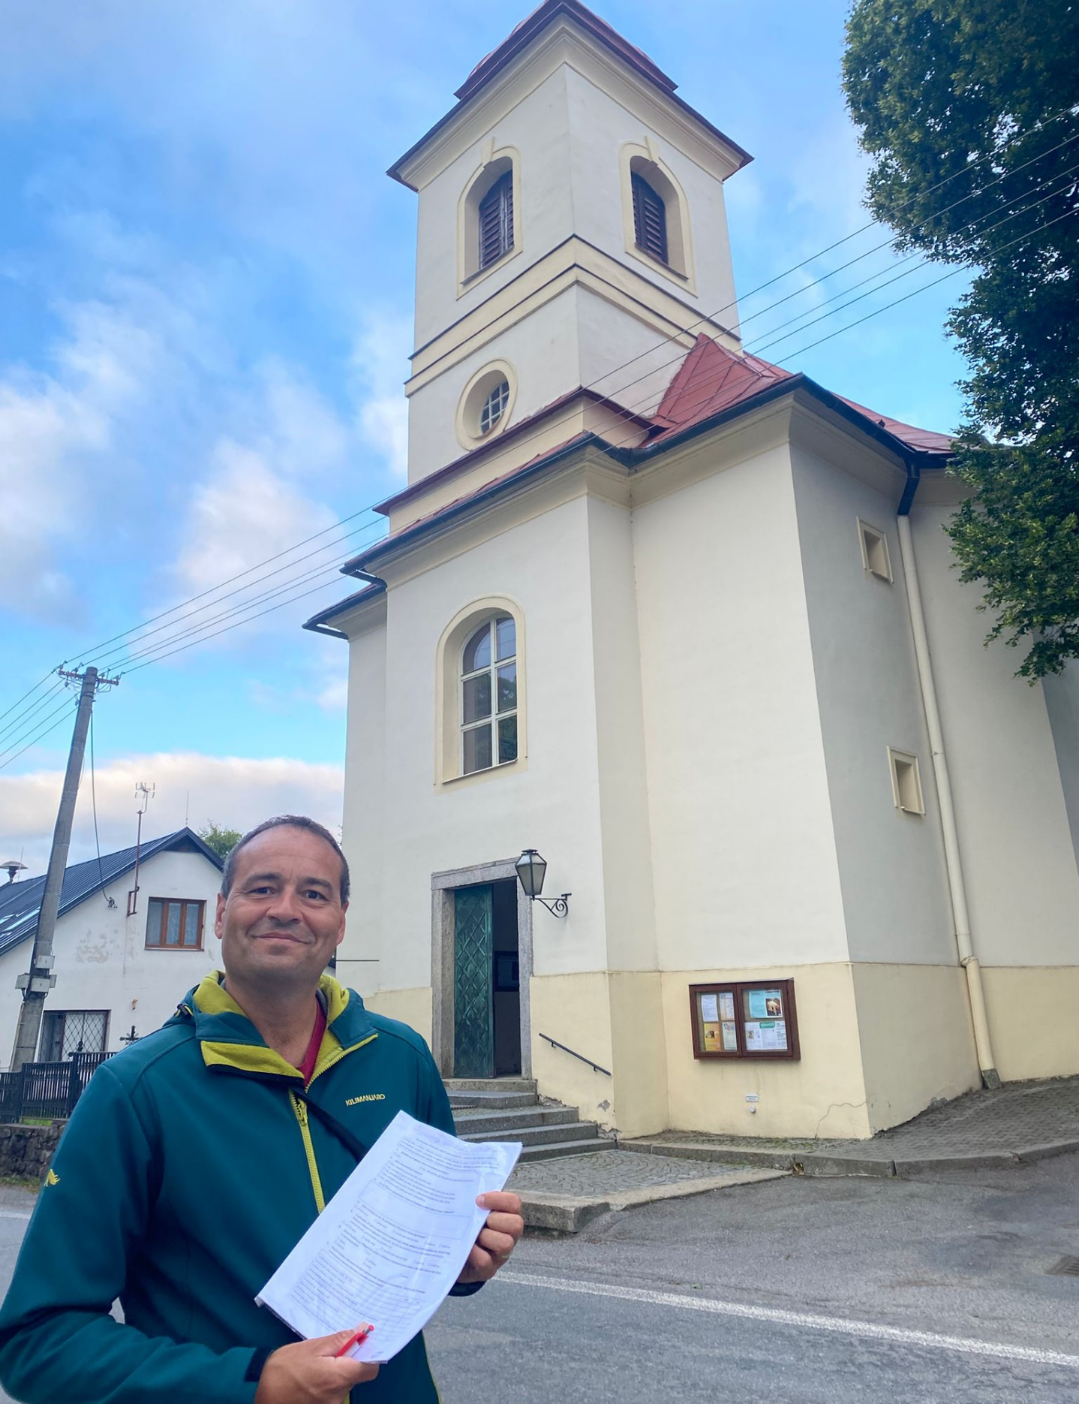
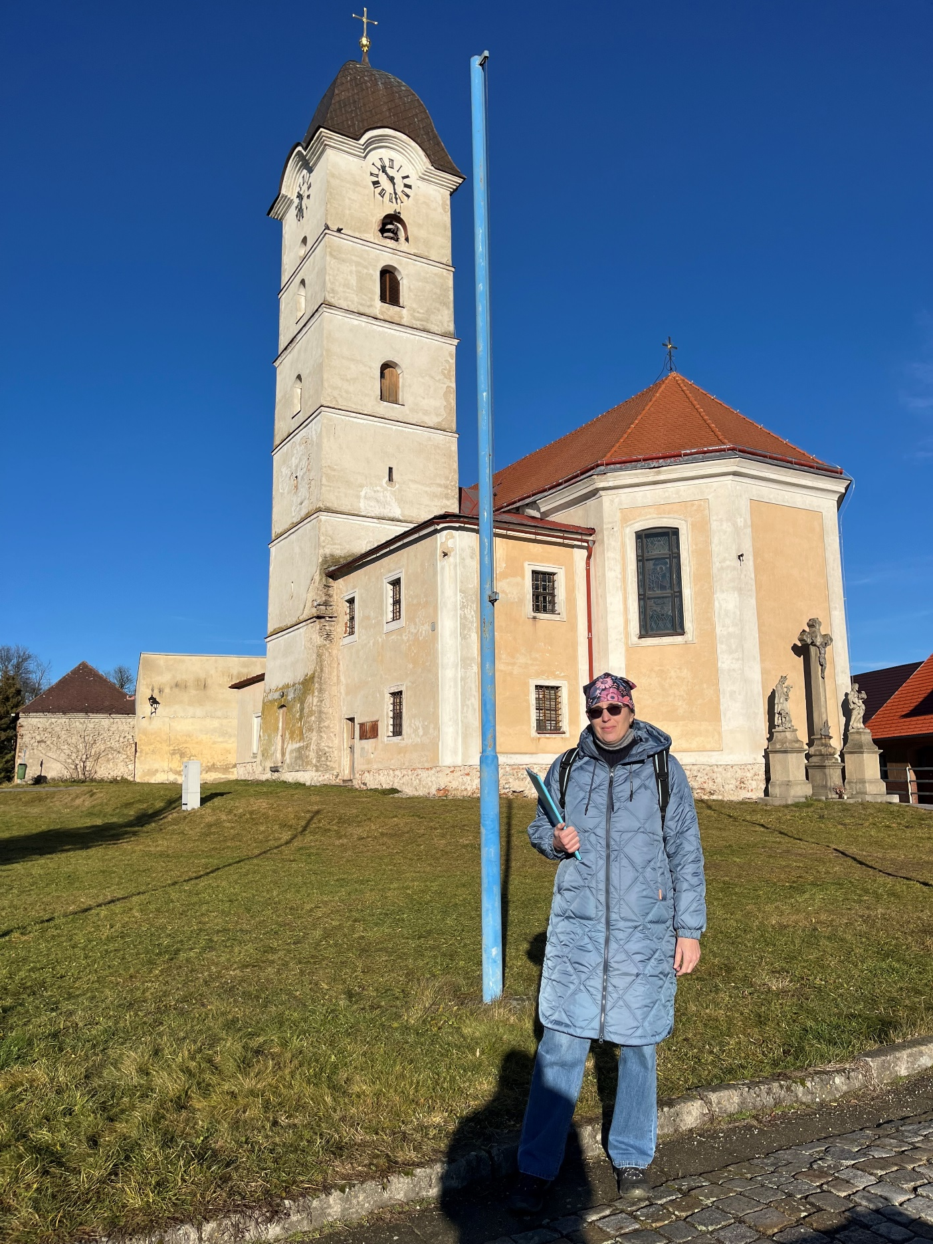
QUESTIONNAIRE SURVEY

Slide 14
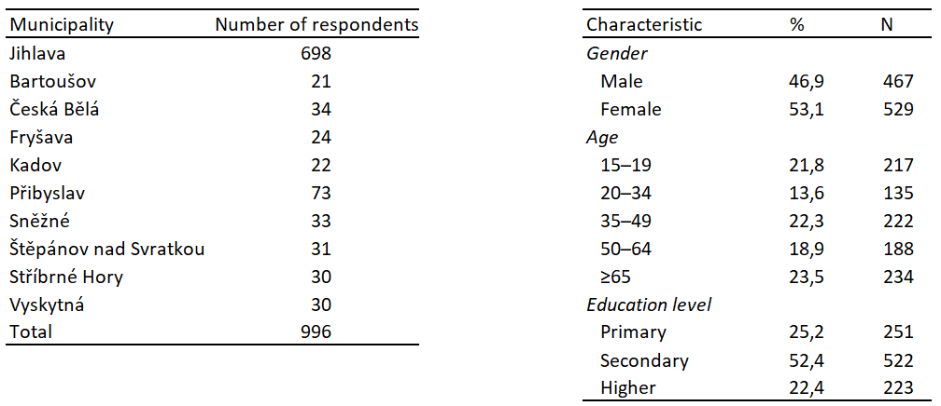
MATERIALS AND METHODS
996 residents of Jihlava and nine smaller mining-linked municipalities in the Vysočina Region
May 2024 to December 2025 (CAWI and PAPI methods)

Slide 15
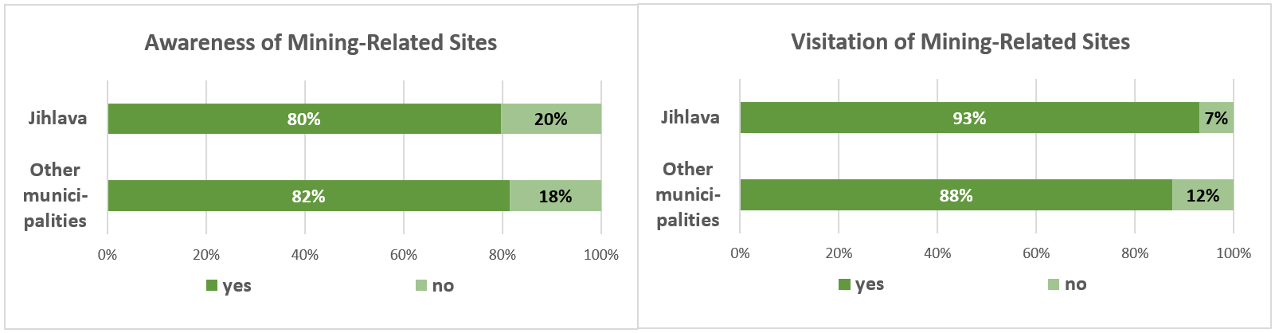
RESULTS
Respondents' awareness and visitation of mining-related sites

Slide 16
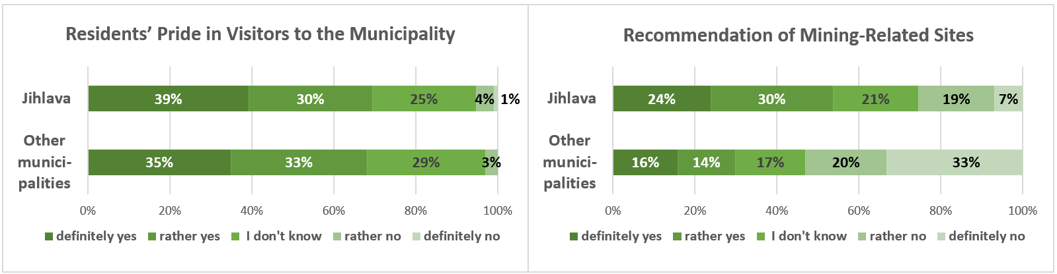
RESULTS
Residents' pride in visitors and recommendation of mining-related sites

Slide 17
CONCLUSION
Study illuminates residents' high awareness of and visitation to mining heritage sites, alongside their perceptions of these sites as valuable tourism resources, with notable differences between Jihlava and the surrounding municipalities.
With great regional pride in visitors (68-69%) yet differentiated recommendation behaviours – higher in Jihlava (54% positive) – the findings reveal how cultural identity and personal experiences shape community engagement. These insights enhance understanding of local relations to mining heritage and offer actionable guidance for destination management, heritage interpretation, and community-based tourism strategies in post-mining landscapes.

Slide 18

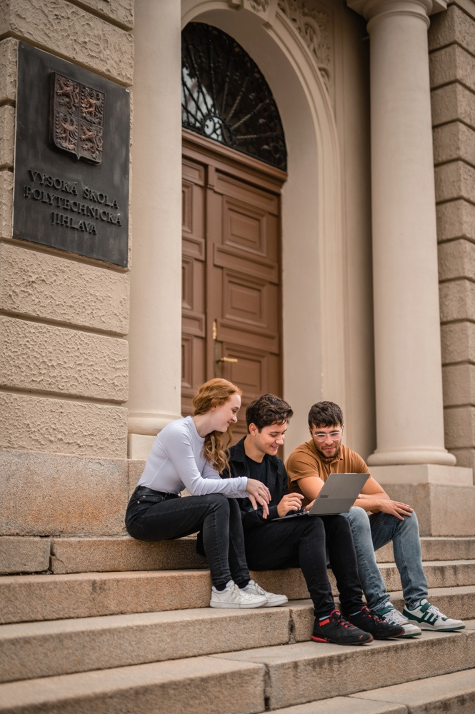
THANK YOU FOR YOUR ATTENTION
Blanka Šimánková Hornová, Tomáš Čihák, Stanislava Pachrová
College of Polytechnics Jihlava
Tolstého 16, 586 01 Jihlava, Czech Republic
E-mails: blanka.simankovahornova@vspj.cz tomas.cihak@vspj.cz
stanislava.pachrova@vspj.cz

