Slide 1
Learning Gains and Student Reservations
Evaluating a GPT-Based AI Assistant in Geography Teaching
Emil Drápela
Department of Geography, Technical University of Liberec
01
Notes:
Emphasise the central paradox: AI-supported practice improved outcomes, but many students still preferred conventional teaching. Keep the presentation focused on the experiment, the results, and the pedagogical interpretation rather than on general AI hype.

Slide 2
CONTEXT
Why AI-supported learning matters
Generative AI is moving from a general productivity tool into a possible tutoring infrastructure for higher education. The question is not only whether it can explain content, but whether it can support disciplinary thinking.
Potential educational value Immediate assistance, repeated practice, adaptive explanations and formative feedback.
Persistent concerns Accuracy, academic integrity, dependency, privacy, bias and ethics.
Geography-specific challenge Learning requires spatial reasoning, causal explanation and interpretation of complex relationships, not only factual recall.
Core tension: efficiency and accessibility do not automatically equal meaningful learning experience.
Emil Drápela | Technical University of Liberec
02
Notes:
Emphasise the central paradox: AI-supported practice improved outcomes, but many students still preferred conventional teaching. Keep the presentation focused on the experiment, the results, and the pedagogical interpretation rather than on general AI hype.

Slide 3
STUDY LOGIC
Aim and research focus
The study evaluates a custom GPT-based assistant designed for university geography students in the course Economic Geography.
Practise geographical relationships
Develop geographical thinking
Explain topics clearly and accurately
Evaluation question 1 Did access to the assistant improve learning outcomes?
Evaluation question 2 Did improved performance translate into positive student acceptance?
Emil Drápela | Technical University of Liberec
03
Notes:
Emphasise the central paradox: AI-supported practice improved outcomes, but many students still preferred conventional teaching. Keep the presentation focused on the experiment, the results, and the pedagogical interpretation rather than on general AI hype.

Slide 4
INTERVENTION
The GPT-based assistant: “Tutor of Economic Geography”
The assistant was created by the course instructor on the ChatGPT platform and grounded in course materials.
Knowledge base Course textbook, lecture presentations and additional supporting materials.
Learning mode Examines students, asks questions of varying difficulty and focuses on selected curriculum parts.
Feedback logic For incorrect or incomplete answers, the assistant gives hints that guide students towards a correct response.
Student answer
AI feedback / hints
More precise explanation
Emil Drápela | Technical University of Liberec
04
Notes:
Emphasise the central paradox: AI-supported practice improved outcomes, but many students still preferred conventional teaching. Keep the presentation focused on the experiment, the results, and the pedagogical interpretation rather than on general AI hype.

Slide 5
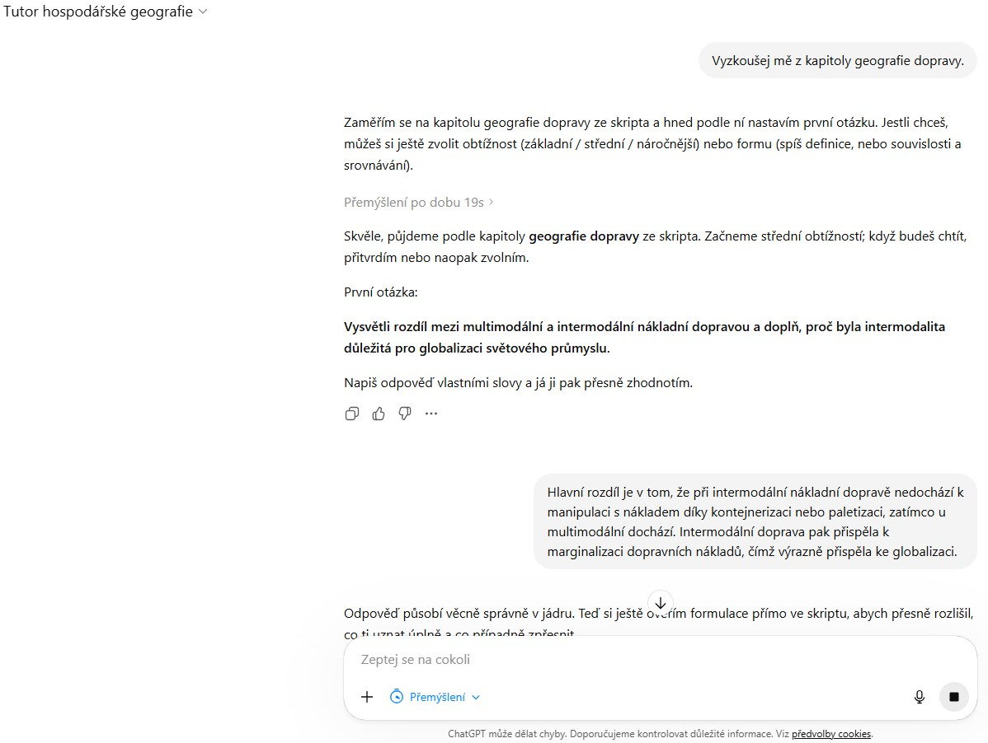

Slide 6
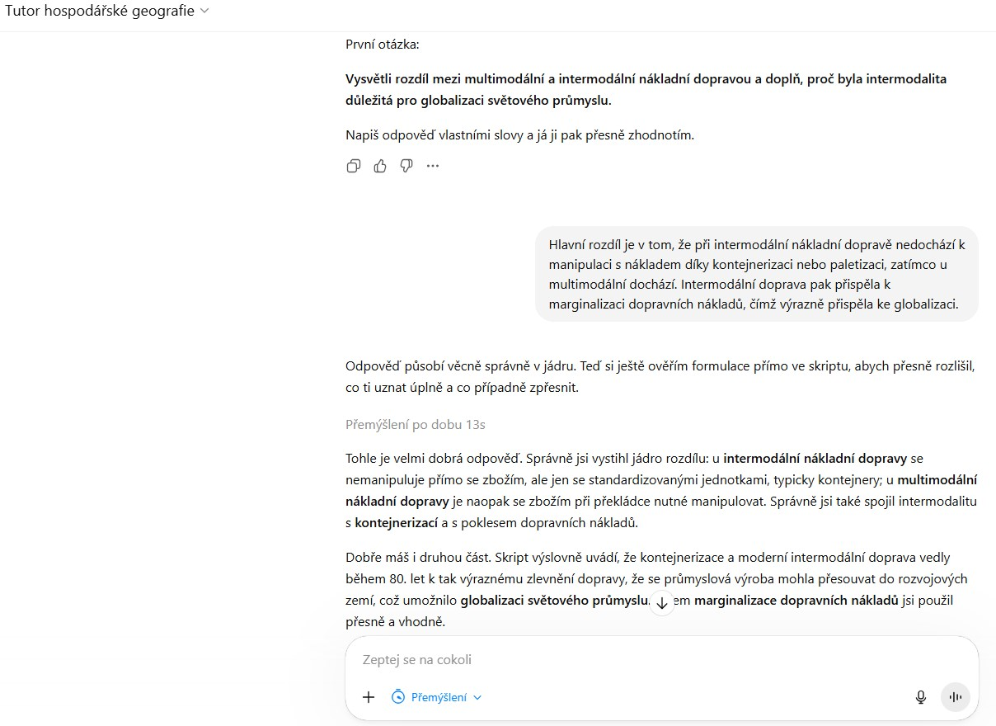

Slide 7
MATERIAL AND METHODS
Experimental design
160
138
78
60
students originally enrolled
completed and included in final evaluation
experimental group
AI assistant access
control group
standard instruction
Pre-test
comparable baseline
Semester intervention
AI access vs. no access
Final test + questionnaire
learning outcomes and perceptions
The pre-test indicated no statistically significant initial difference between the experimental and control groups.
Emil Drápela | Technical University of Liberec
05
Notes:
Emphasise the central paradox: AI-supported practice improved outcomes, but many students still preferred conventional teaching. Keep the presentation focused on the experiment, the results, and the pedagogical interpretation rather than on general AI hype.

Slide 8
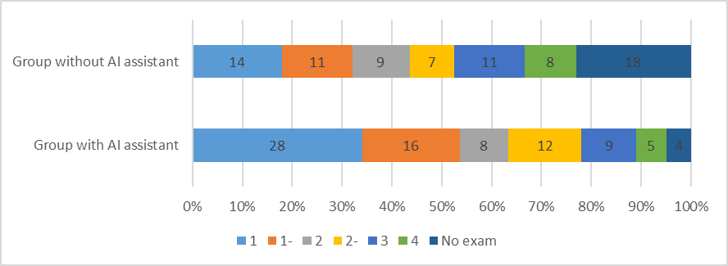
RESULTS I
Learning outcomes: clear advantage for AI-supported practice
Students with access to the AI assistant achieved markedly better final-test results than students in the control group.
Failure rate also decreased The semester failure rate, defined as not taking the final examination, was substantially lower in the experimental group.
Interpretation The assistant likely supported repeated practice and stricter formulation of accurate geographical explanations.
Result: cognitive benefit is visible, even if the exact mechanism requires further study.
Emil Drápela | Technical University of Liberec
06
Notes:
Emphasise the central paradox: AI-supported practice improved outcomes, but many students still preferred conventional teaching. Keep the presentation focused on the experiment, the results, and the pedagogical interpretation rather than on general AI hype.

Slide 9
RESULTS II
The acceptance paradox
Despite better learning outcomes, student attitudes towards the AI assistant remained reserved.
54%
29%
17%
preferred conventional teaching
(42 students)
evaluated the assistant positively
(23 students)
other or ambivalent responses
(approx. 13 students)
Measurable learning gains did not automatically become positive attitudes toward AI-supported learning.
Emil Drápela | Technical University of Liberec
07
Notes:
Emphasise the central paradox: AI-supported practice improved outcomes, but many students still preferred conventional teaching. Keep the presentation focused on the experiment, the results, and the pedagogical interpretation rather than on general AI hype.

Slide 10
QUALITATIVE INSIGHTS
What students appreciated and criticised
Appreciated features Available anytime and anywhere; mobile access; conversational interaction; repetitive revision became more engaging; students valued having an additional support tool.
Main reservations Overly strict assessment of answers; insufficient empathy; lack of the human element; frustration after repeated failure to provide a fully correct answer.
Only a very small number of open-ended responses explicitly mentioned factual or technical errors, although such limitations were present in some numerical or ordering tasks.
The dominant issue was not simply technical reliability, but interaction style.
Emil Drápela | Technical University of Liberec
08
Notes:
Emphasise the central paradox: AI-supported practice improved outcomes, but many students still preferred conventional teaching. Keep the presentation focused on the experiment, the results, and the pedagogical interpretation rather than on general AI hype.

Slide 11
DISCUSSION
Interpreting the paradox
1. Relational and affective dimension Learning is also social and emotional. Teacher friendliness, empathy, encouragement and interpersonal understanding create safety, trust and motivation.
2. Rigorous feedback and student expectations The assistant consistently rejected imprecise answers. This may have improved precision, but also made students experience strictness as uncomfortable or discouraging.
Cognitive rigour
Learning gains
Emotional acceptance
The AI assistant may have been effective partly because it was strict — precisely the feature that some students disliked.
Emil Drápela | Technical University of Liberec
09
Notes:
Emphasise the central paradox: AI-supported practice improved outcomes, but many students still preferred conventional teaching. Keep the presentation focused on the experiment, the results, and the pedagogical interpretation rather than on general AI hype.

Slide 12
CONCLUSION
Implications for AI in geography teaching
AI tools should not be evaluated only by performance outcomes. Their educational success also depends on how students experience the interaction.
Design implication Combine cognitive rigour with supportive, emotionally sensitive communication.
Teaching implication Use AI as a complementary practice environment, not as a replacement for teacher guidance and rapport.
Research implication Future studies should connect learning analytics, student perceptions and the quality of AI feedback.
Better results are necessary, but not sufficient, for acceptance.
Emil Drápela | Technical University of Liberec
10
Notes:
Emphasise the central paradox: AI-supported practice improved outcomes, but many students still preferred conventional teaching. Keep the presentation focused on the experiment, the results, and the pedagogical interpretation rather than on general AI hype.

Slide 13
Thank you
Questions and discussion
Mgr. Emil Drápela, Ph.D.
Department of Geography, Faculty of Science, Humanities and Education
Technical University of Liberec
emil.drapela@tul.cz
11
Notes:
Emphasise the central paradox: AI-supported practice improved outcomes, but many students still preferred conventional teaching. Keep the presentation focused on the experiment, the results, and the pedagogical interpretation rather than on general AI hype.

